Slide 1
From Power BI to Power Platform
Microsoft Store Oxford Circus
Wednesday 5th Feb 2020
Presenter David Moss

Slide 2
Agenda
5th Feb: Intro Power Platform, PL-900, onboard, 1st app & CDS
19th Feb: Power Apps
4th March: Power Automate
25th March: Power BI
8th April: Power Platform summary; practice exam

Slide 3
Session 1
POWA10 : Intro to Power Platform & Power Apps
PL-900 Certification (pdf)
Onboard user accounts or community account.
Do Power Platform fundamentals MS Learn Step 3 (1&2 self read).
POWA40 : Intro to CDS
Guest speaker Samit Saini
5 weeks: wottabyte, slack, coursework etc..
CDS Learn labs
Name.surname@wottabyte.com

Slide 4
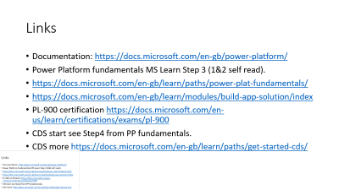
Links
Documentation: https://docs.microsoft.com/en-gb/power-platform/
Power Platform fundamentals MS Learn Step 3 (1&2 self read).
https://docs.microsoft.com/en-gb/learn/paths/power-plat-fundamentals/
https://docs.microsoft.com/en-gb/learn/modules/build-app-solution/index
PL-900 certification https://docs.microsoft.com/en-us/learn/certifications/exams/pl-900
CDS start see Step4 from PP fundamentals.
CDS more https://docs.microsoft.com/en-gb/learn/paths/get-started-cds/

Slide 5
Links
Community Plan https://powerapps.microsoft.com/en-us/communityplan/
Power BI https://powerbi.microsoft.com/
Power Apps Studio https://make.powerapps.com
Power Apps Admin https://admin.powerapps.com
Power Automate https://flow.microsoft.com
Power Virtual Agent https://powervirtualagents.microsoft.com/

Slide 6
Key Takeaway: Power Platform
Power BI: ‘Analyze’; Gain insights from data
Power Apps: ‘Act’; drive intelligent business processes
Power Automate: ‘Automate’ business processes
Documentation: https://docs.microsoft.com/en-gb/power-platform/

Slide 7
PL-900 Power Apps and the Power Platform
David Moss
Head of Data & AI @ Wottabyte

Slide 8
Power Apps for Power Platform PL-900
Microsoft Store Oxford Circus
Wednesday 19th Feb 2020
Presenter David Moss

Slide 9
Agenda
5th Feb: Intro Power Platform, PL-900, onboard, 1st app & CDS
19th Feb: Power Apps
4th March: Power Automate
25th March: Power BI
8th April: Power Platform summary; practice exam

Slide 10
Wednesday 19th Agenda
Power Platform certification PL-900 & platform review
Last session : Power Platform, CDS & 1st quick app.
Power Apps intro & features
Power Apps demo
Lab build a canvas app
CDS & Entities for Model driven apps
Next session Power Automate

Slide 11
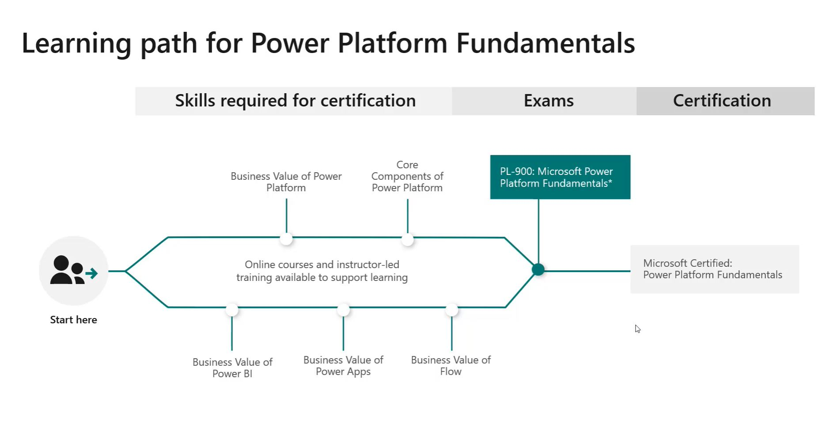

Slide 12
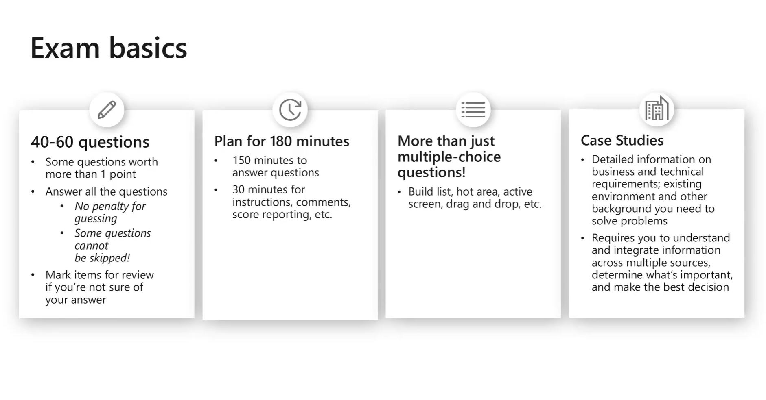

Slide 13
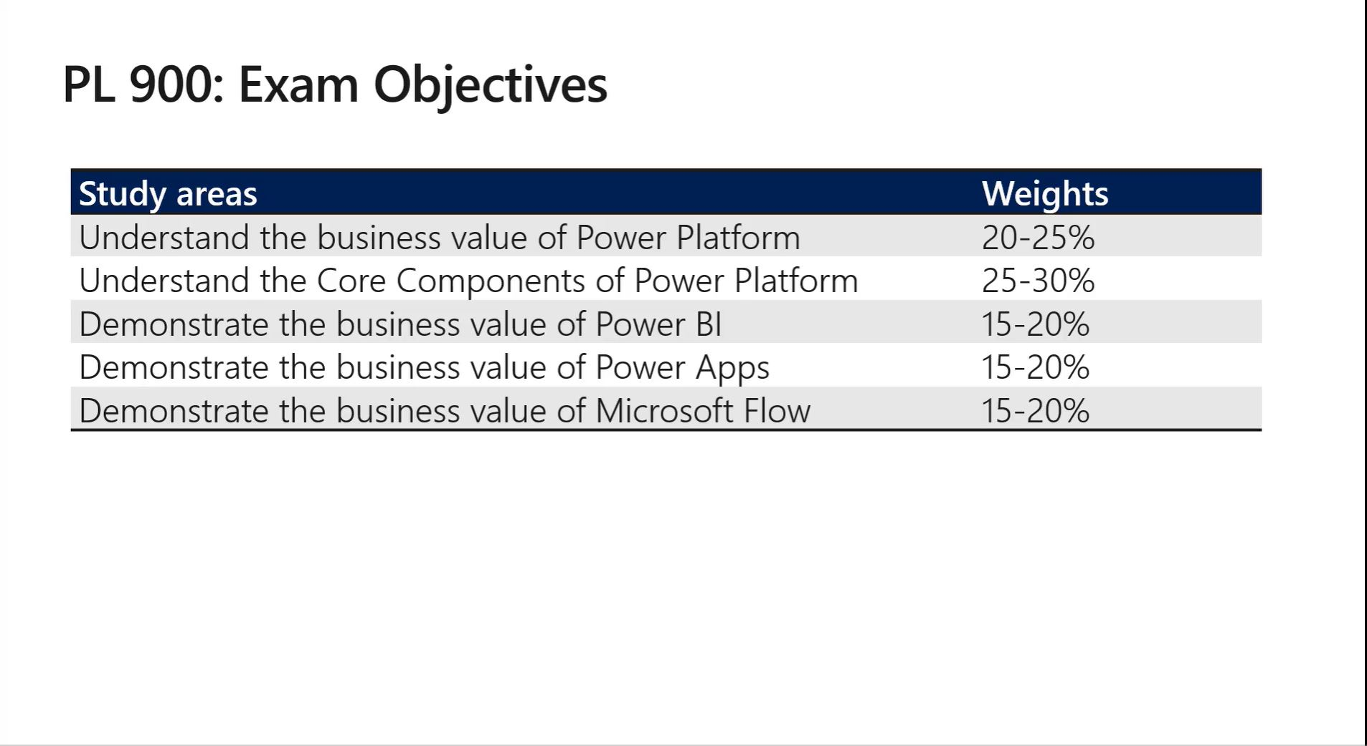
https://docs.microsoft.com/en-us/learn/certifications/exams/pl-900

Slide 14
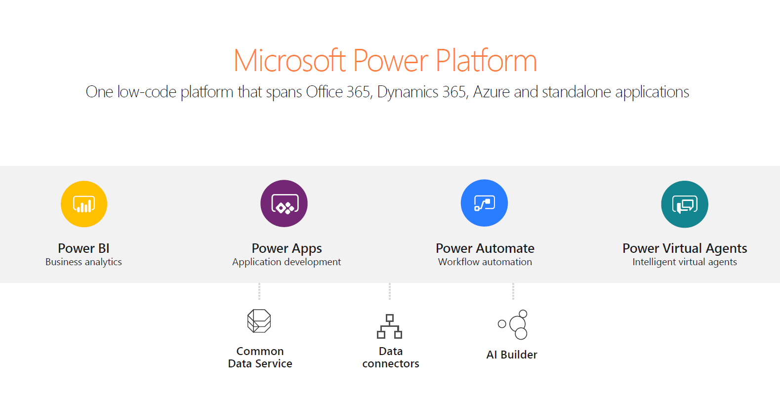

Slide 15
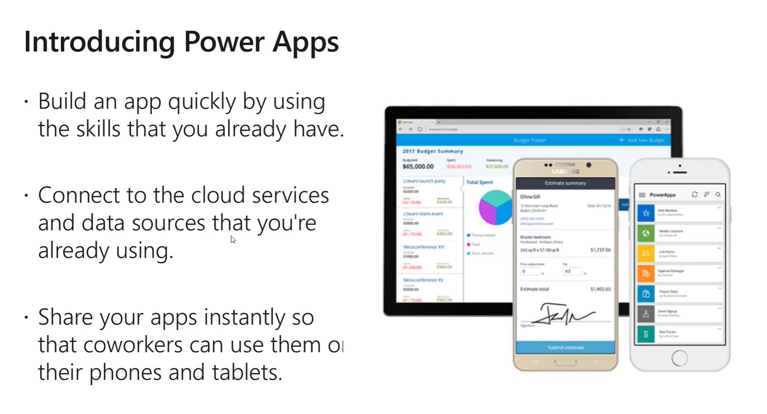

Slide 16

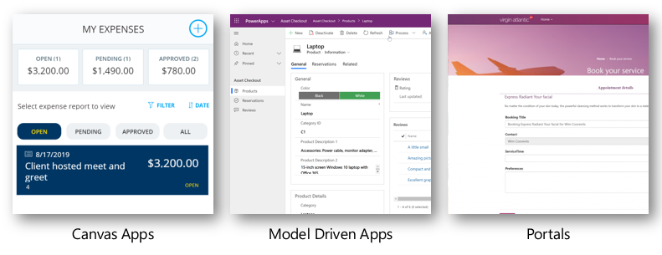

Slide 17
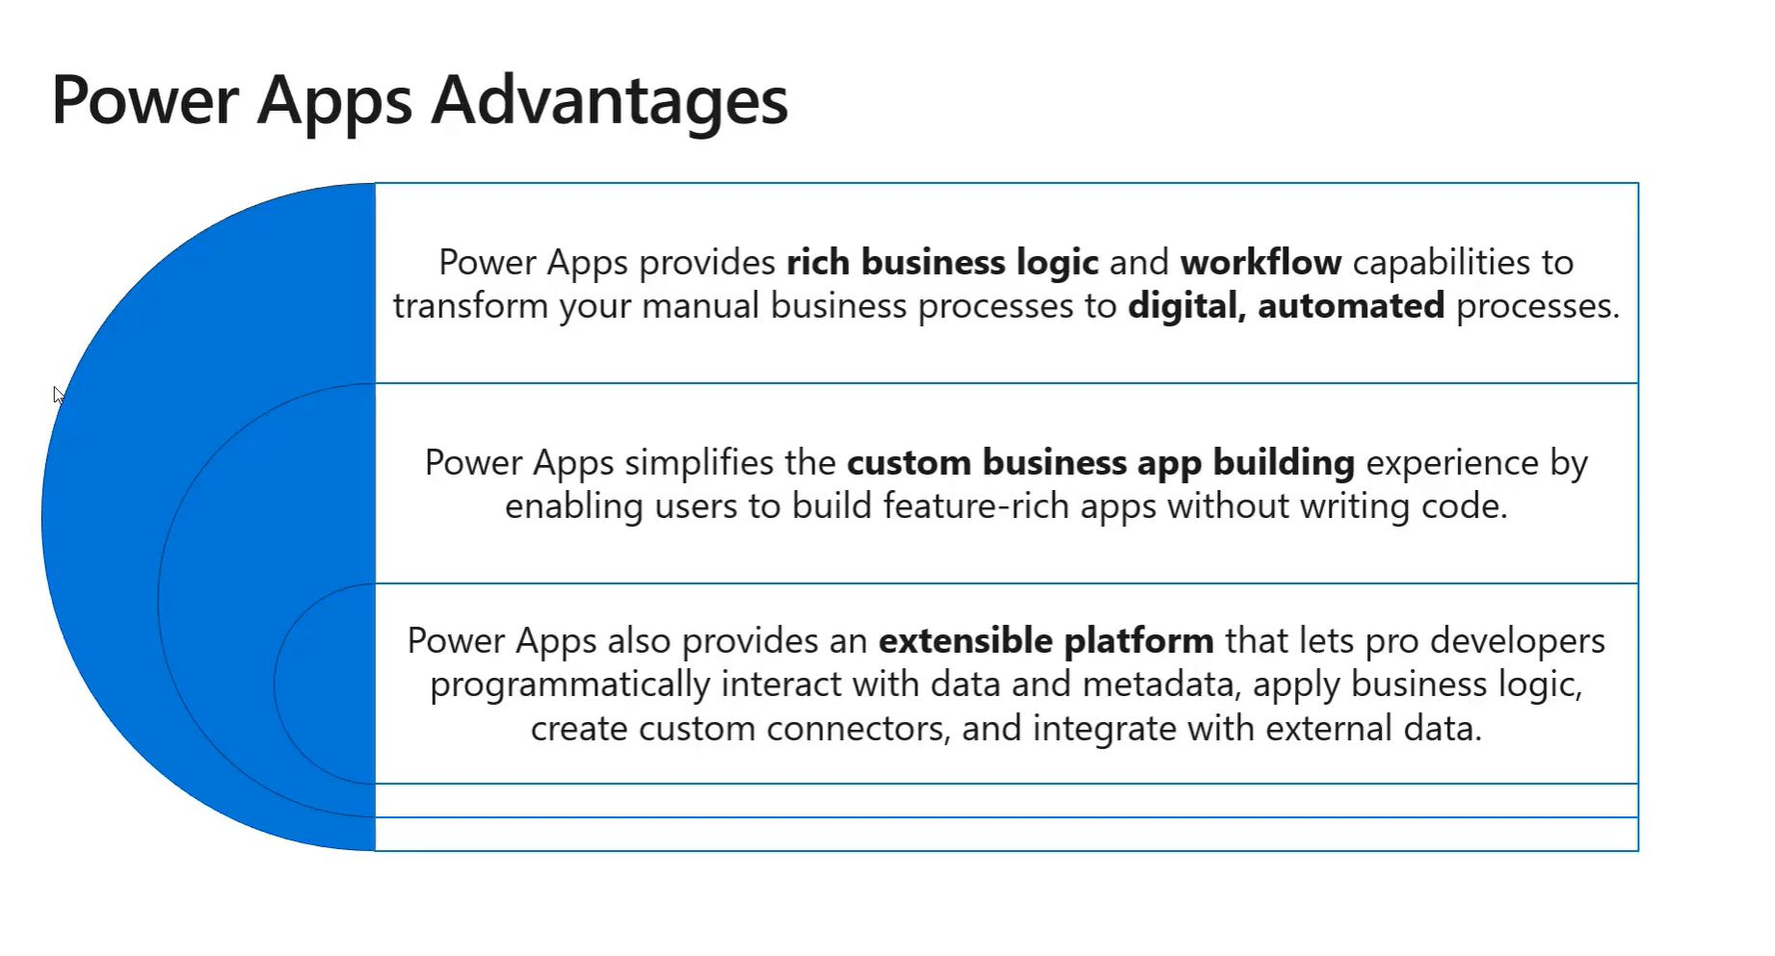

Slide 18
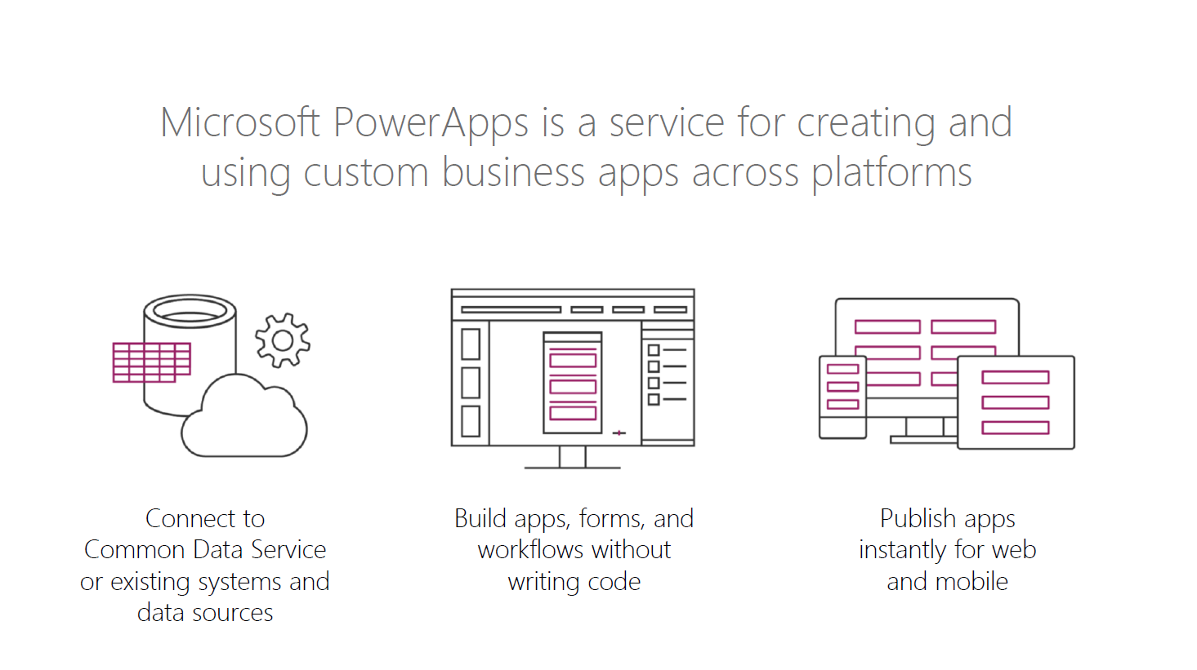

Slide 19
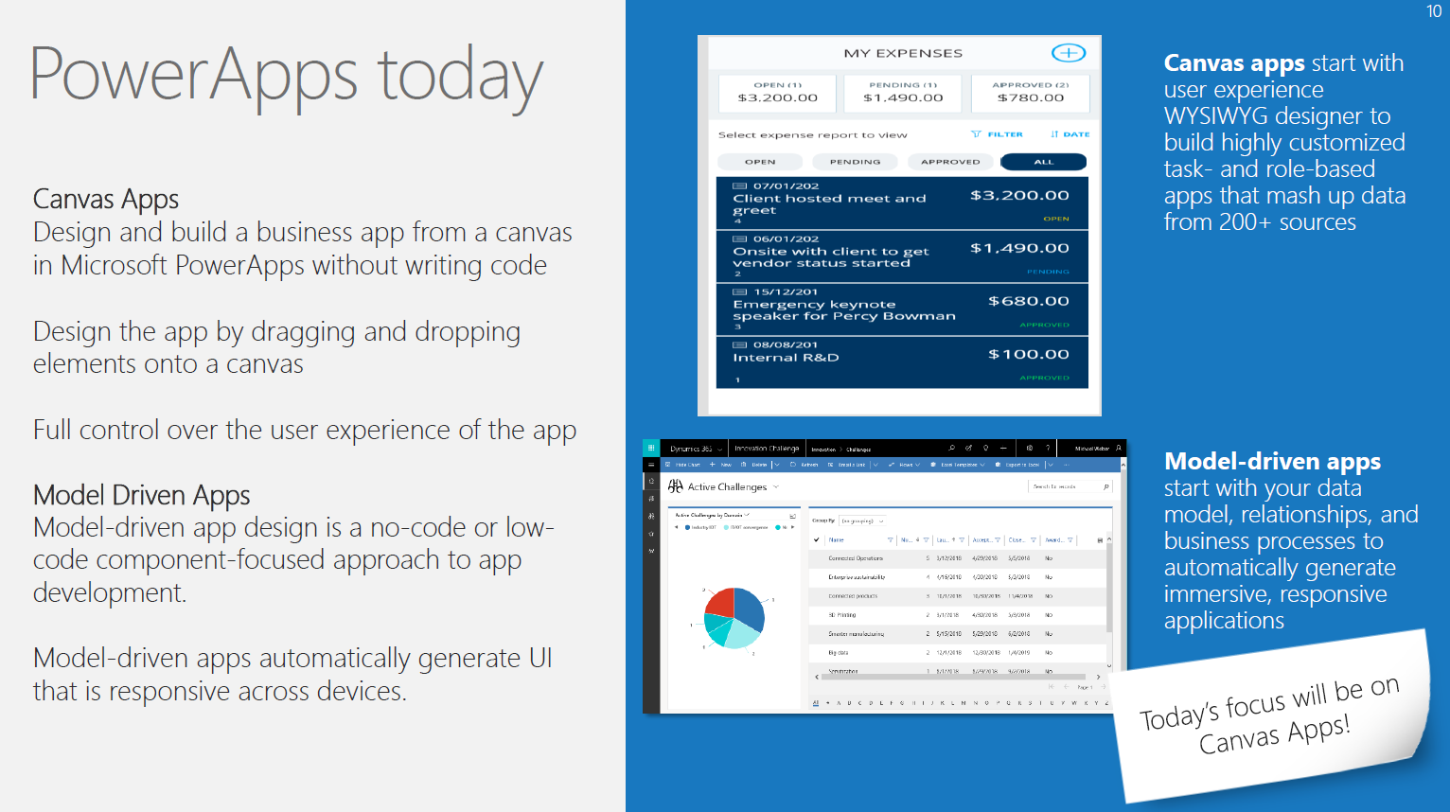

Slide 20
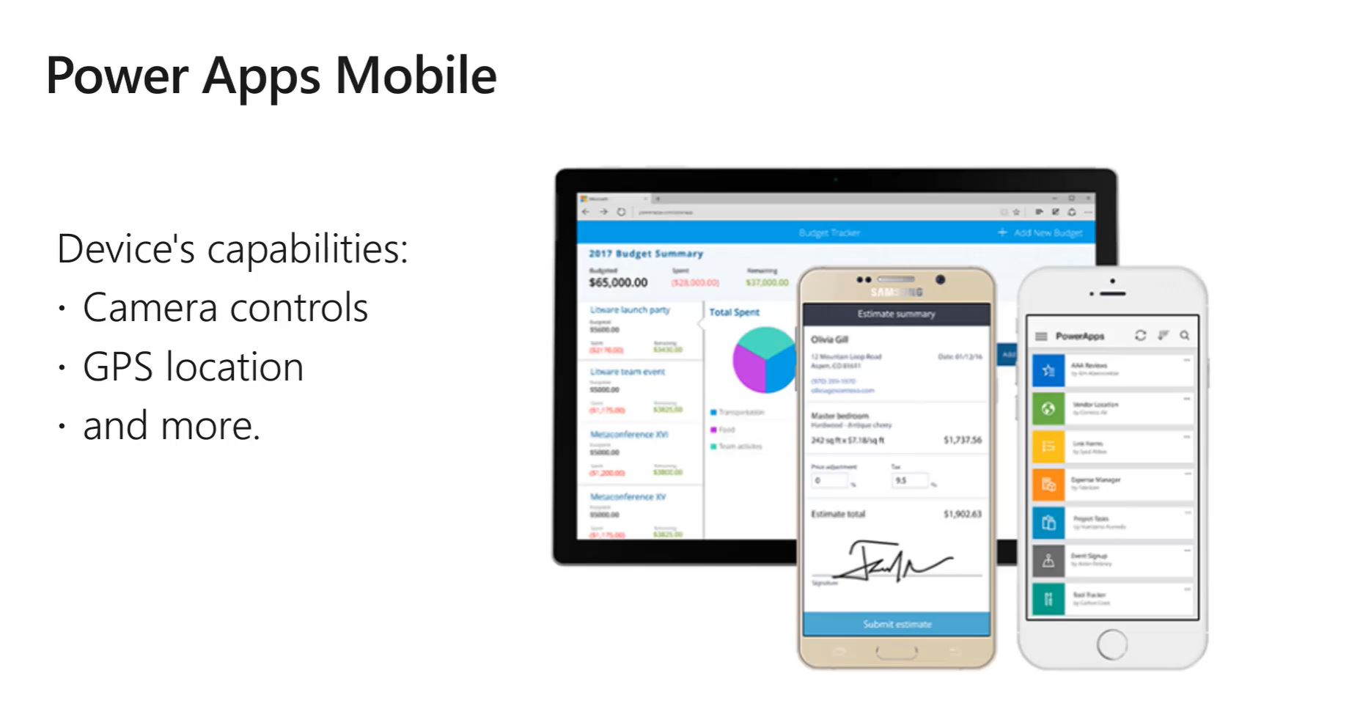

Slide 21
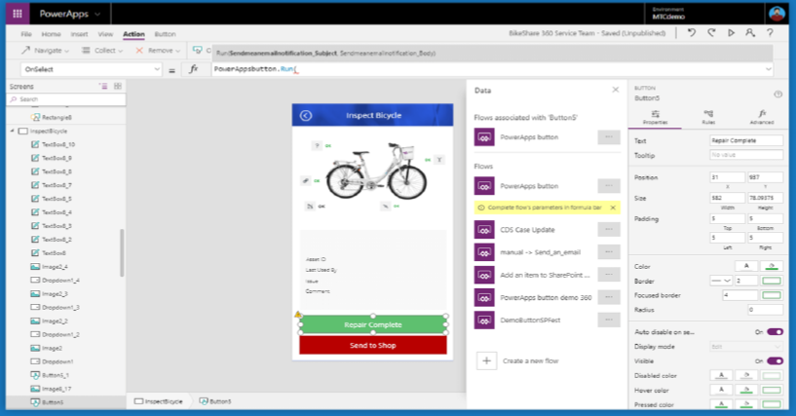
Power Apps Studio

Slide 22
Building Blocks & Key portals
Power Platform admin https://admin.powerplatform.microsoft.com
Power Apps admin https://admin.powerapps.com/
Power Apps maker https://make.powerapps.com/
Create apps in the Power Apps Studio https://eu.create.powerapps.com/studio
Power Apps Mobile app for android, IoS
Walk through each portal showing features

Slide 23
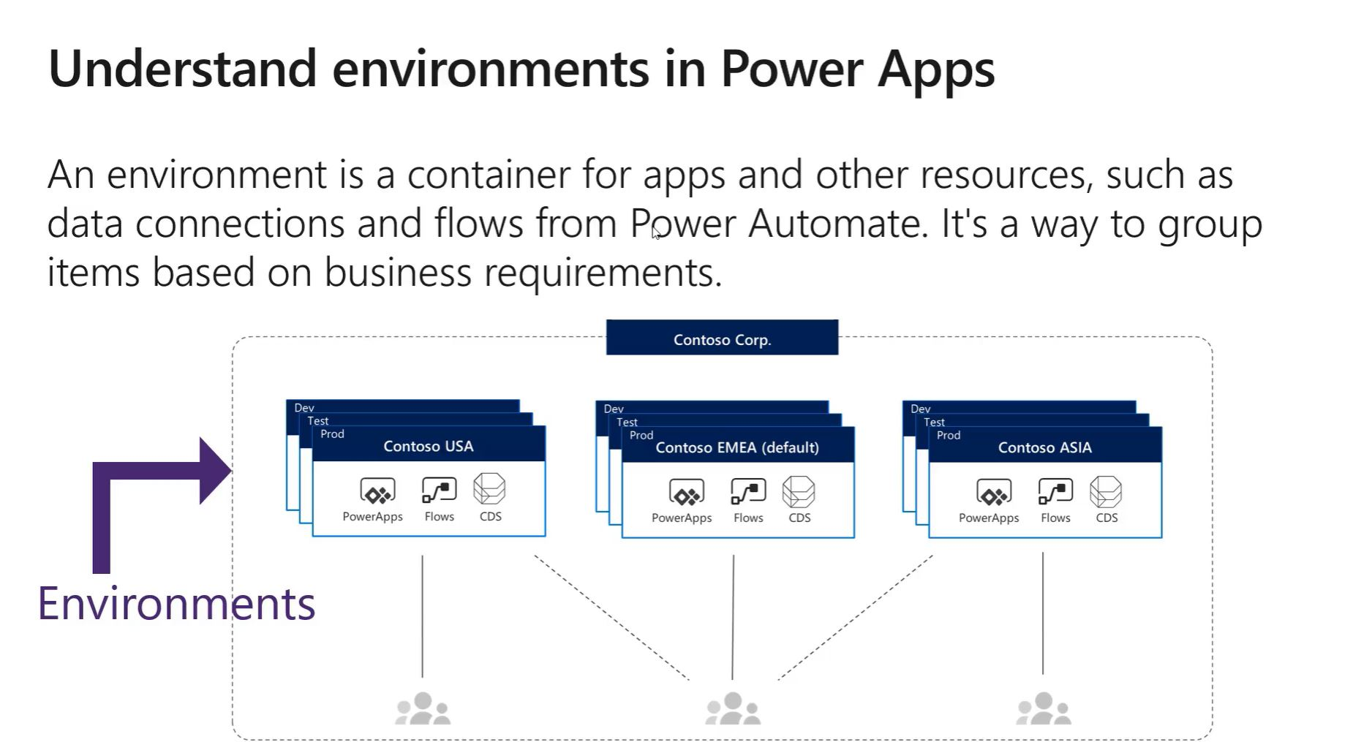
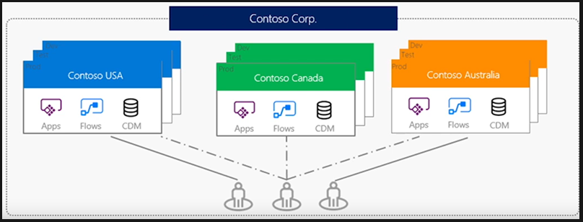
Environments
Similar to a Power BI Workspace
Dev Ops in a .zip Solutions file
Sorry you cannot create an environment in Wottabyte as uses storage 1GB per environment £40/month.

Slide 24
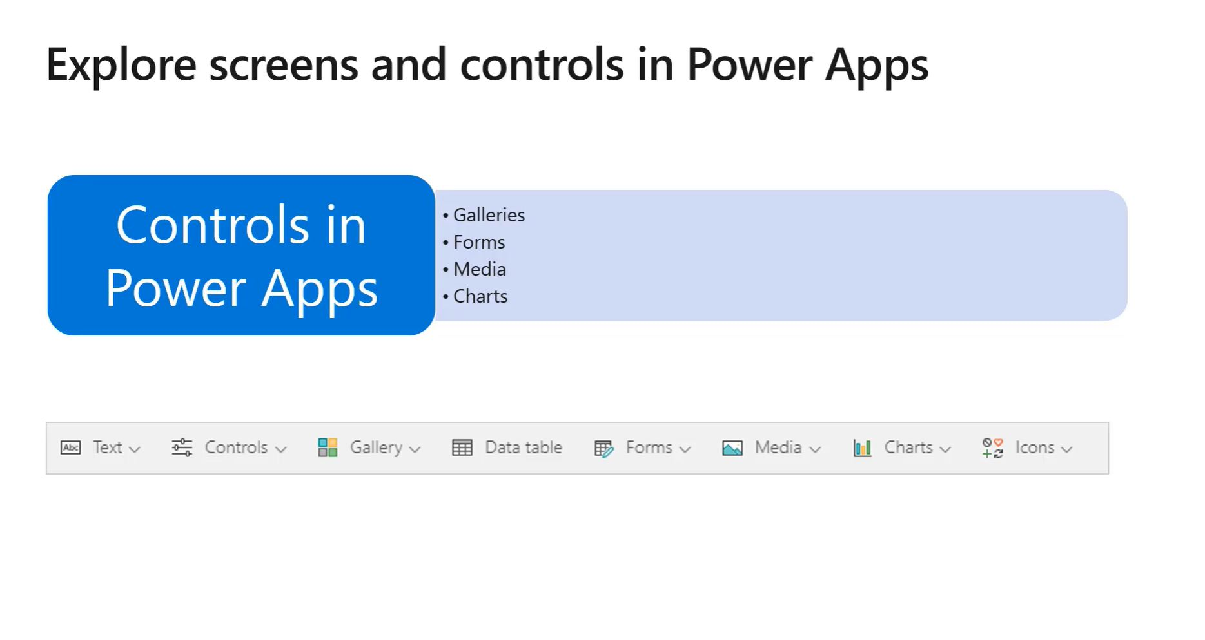
Controls
Galleries
Forms
Media
Charts

Slide 25
Where to start to Create apps
Templates
Start with Data
App created from Sharepoint (show Contoso Tweets)
From Blank

Slide 26
Stop. 1 min break. Think social media.
Take a photo of full room
Do a video promo 15 sec. Crowd shout ‘Power Platform’
All connect on LinkedIn
Attendees take photos and share on twitter, Linkedin, etc
@wottabyte #powerplatform
Share your photos on Slack

Slide 27
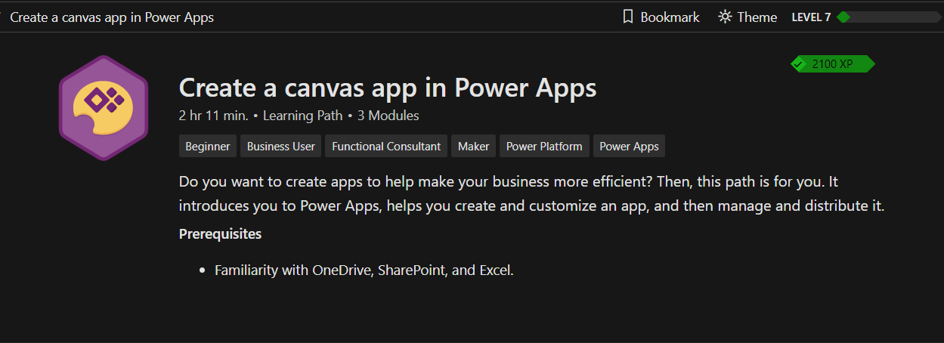
Lab : Create a canvas App in Power Apps (3 mods)
https://docs.microsoft.com/en-gb/learn/paths/create-powerapps/
Mod 1 ‘Get Started with Power Apps. Goto lesson 5 ‘Create your first app in Power Apps’.
Mod 2 ‘Customize a canvas app in Power Apps’. Walk through this in class.
Mod 3 ‘Manage apps in Power Apps’. Speed read through this in class.

Slide 28
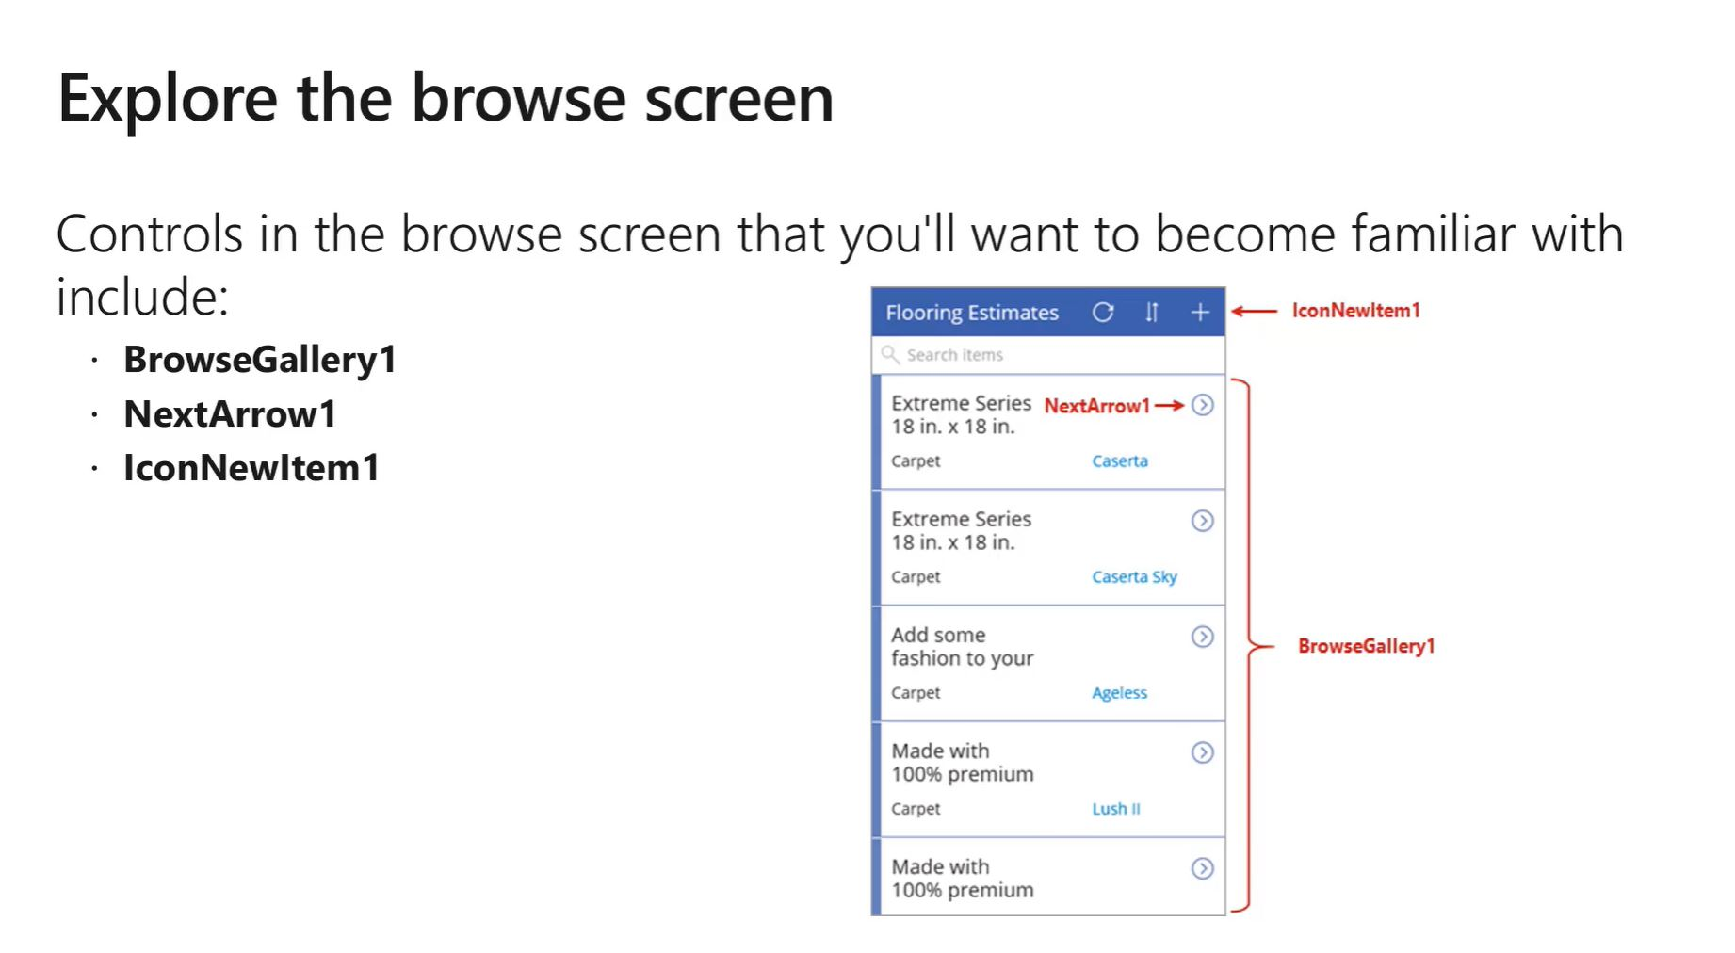

Slide 29
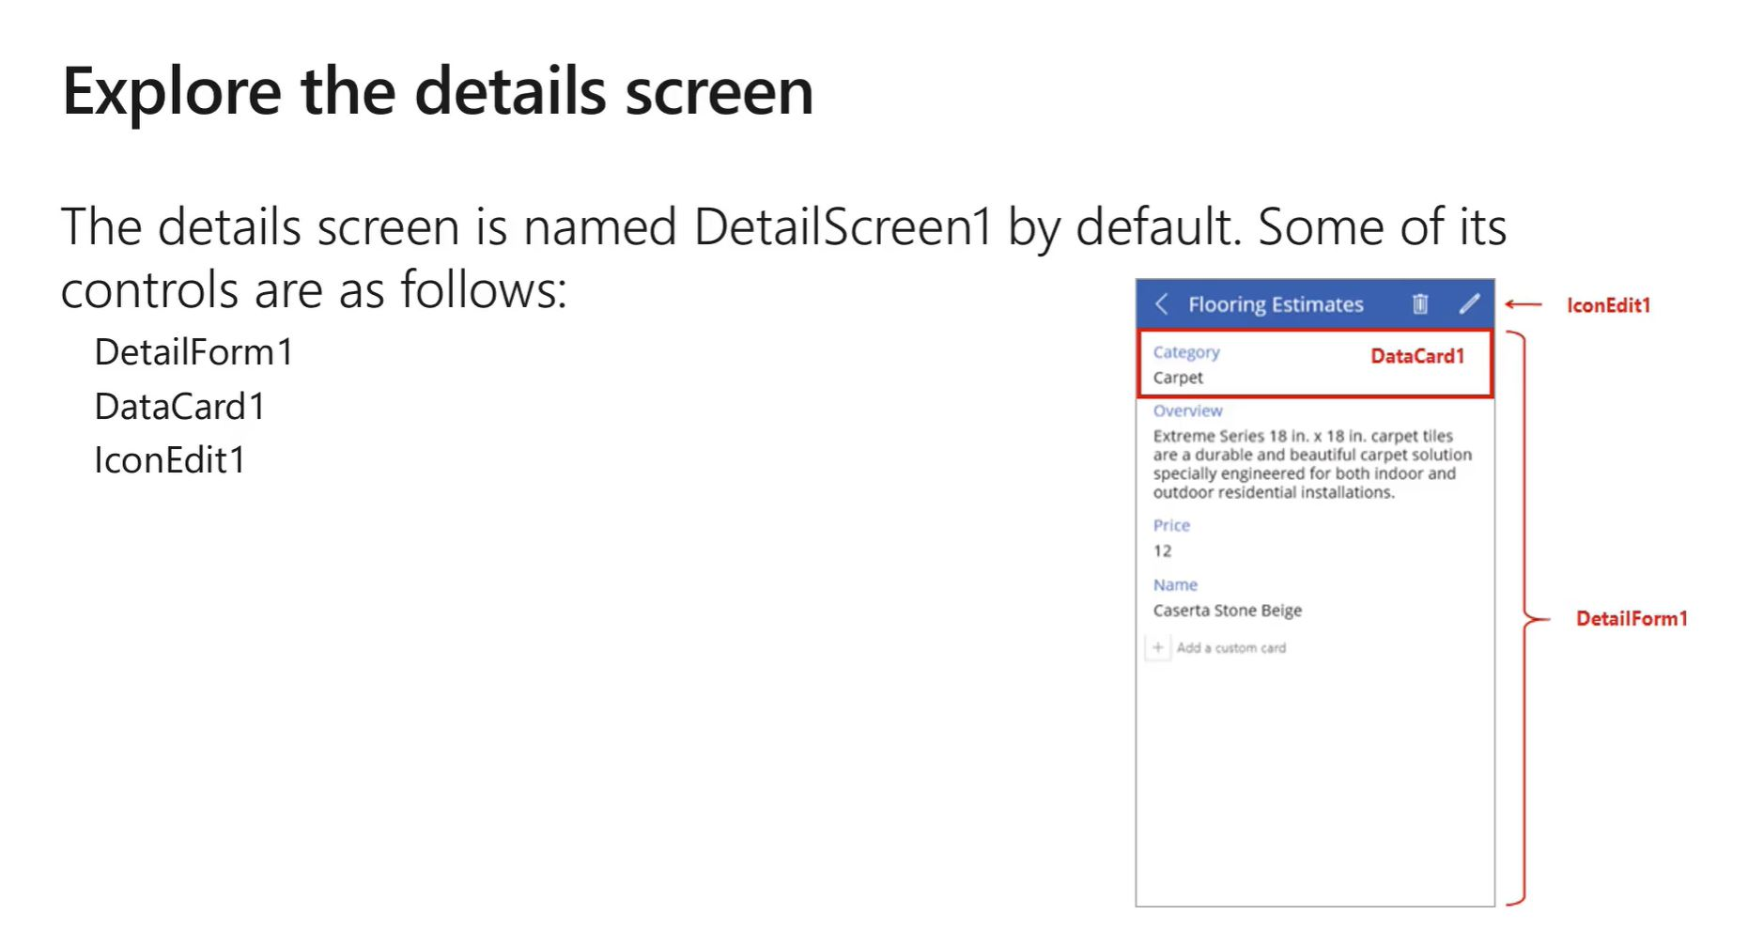

Slide 30
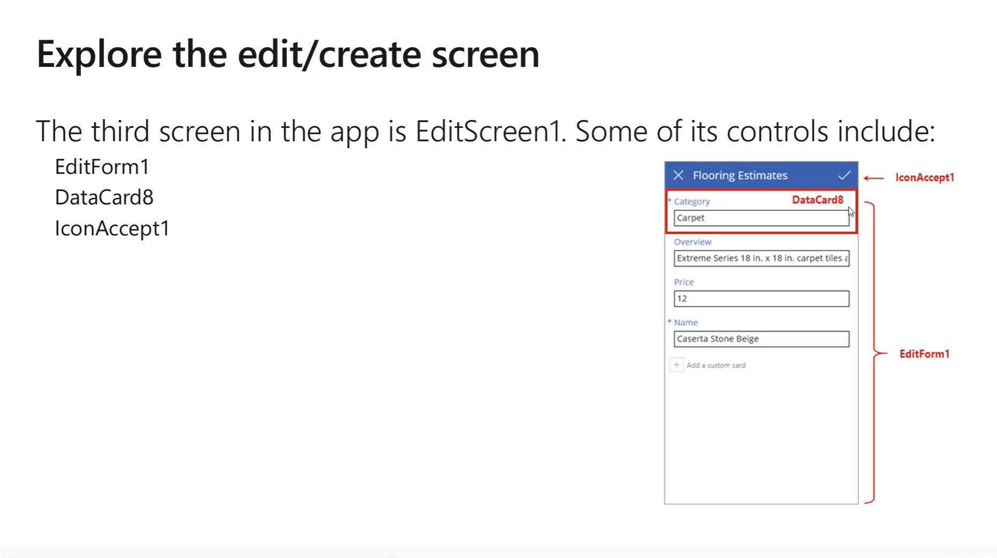

Slide 31
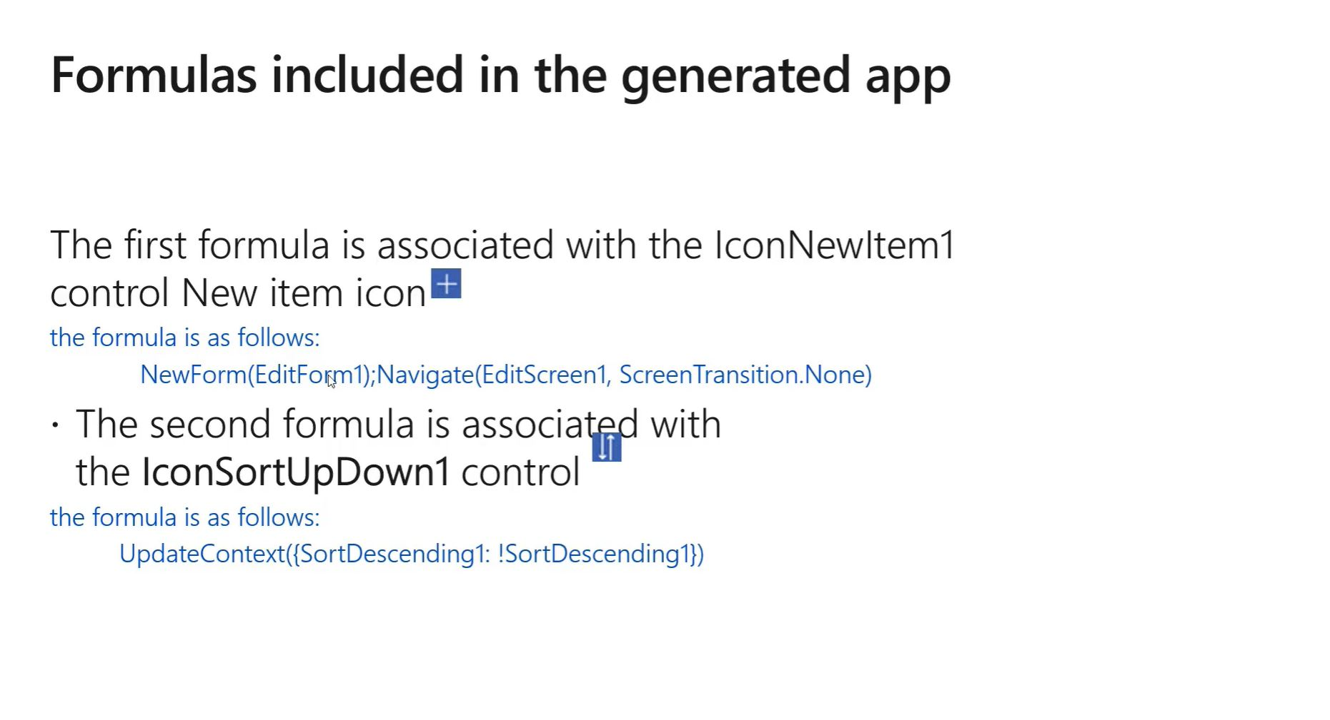

Slide 32
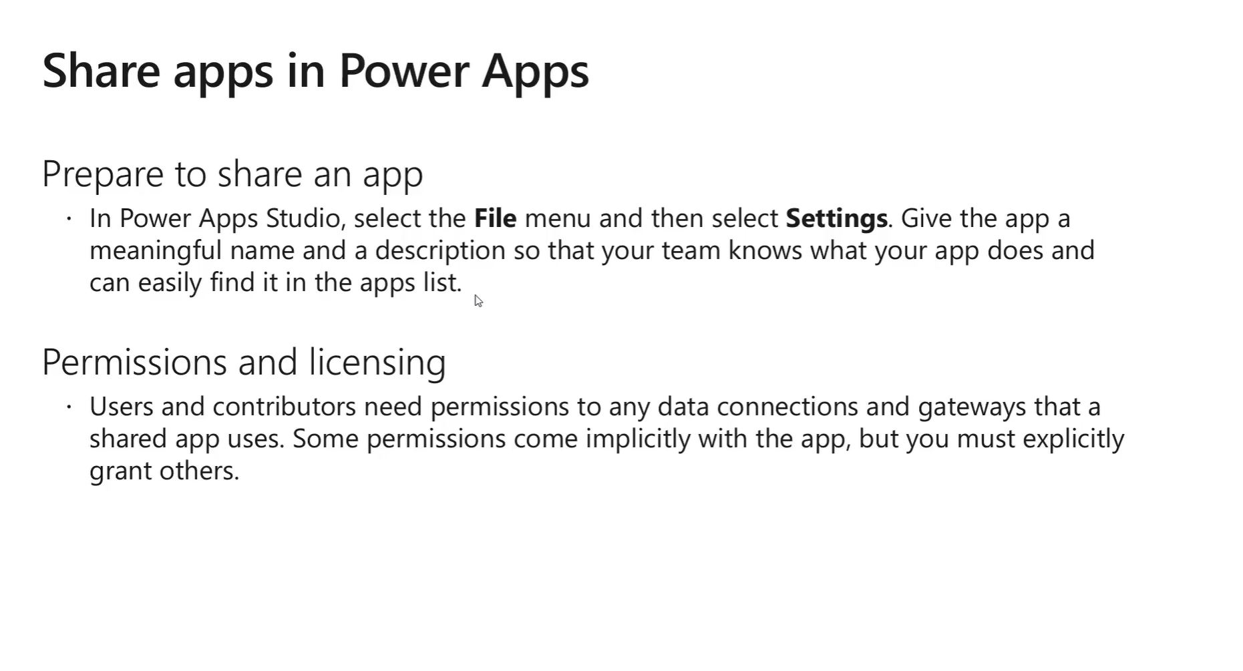

Slide 33
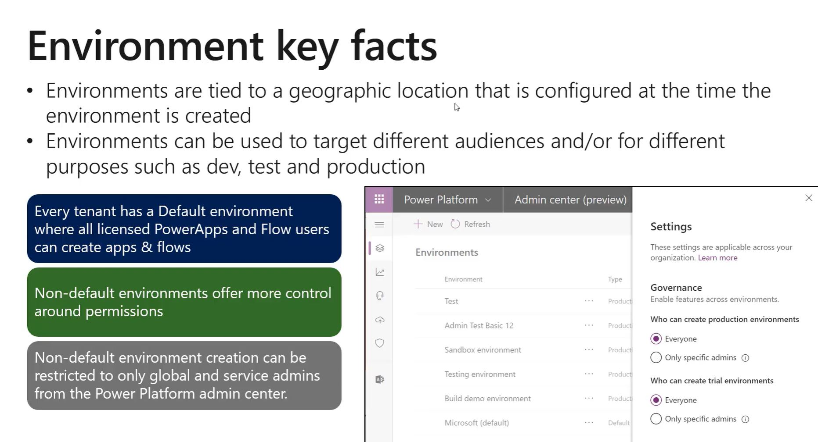

Slide 34
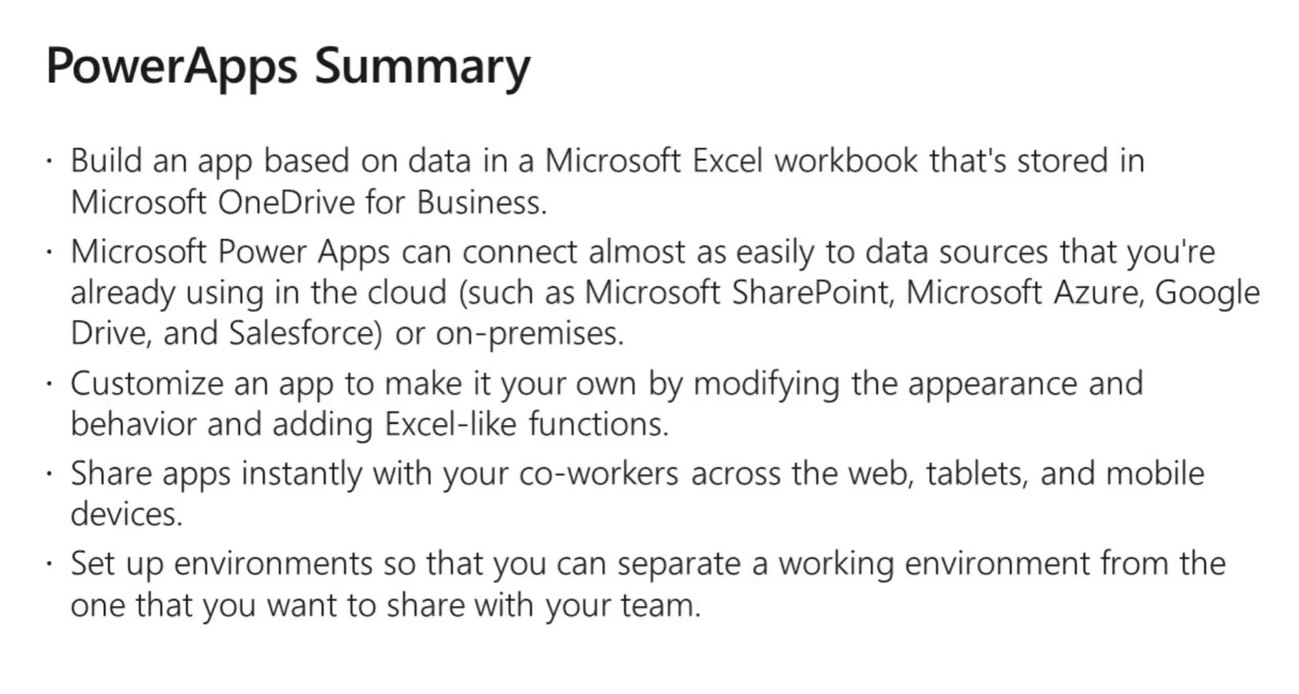

Slide 35
Model Driven Apps
Business process apps
Common Data Service
IPA – CDS more than a database
Entities

Slide 36
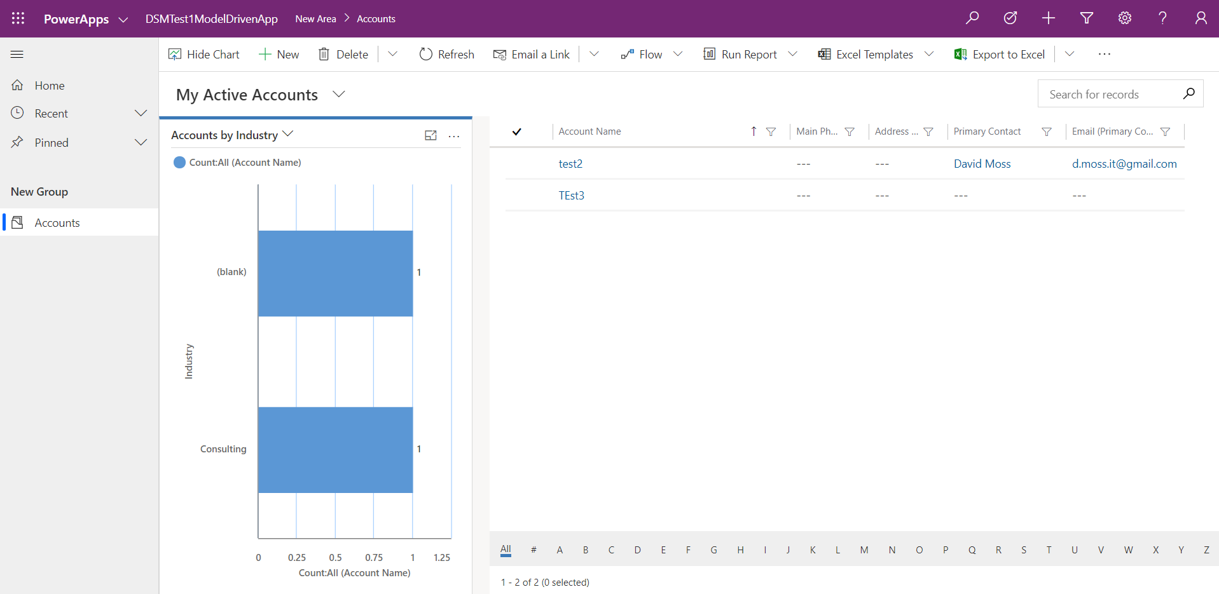

Slide 37
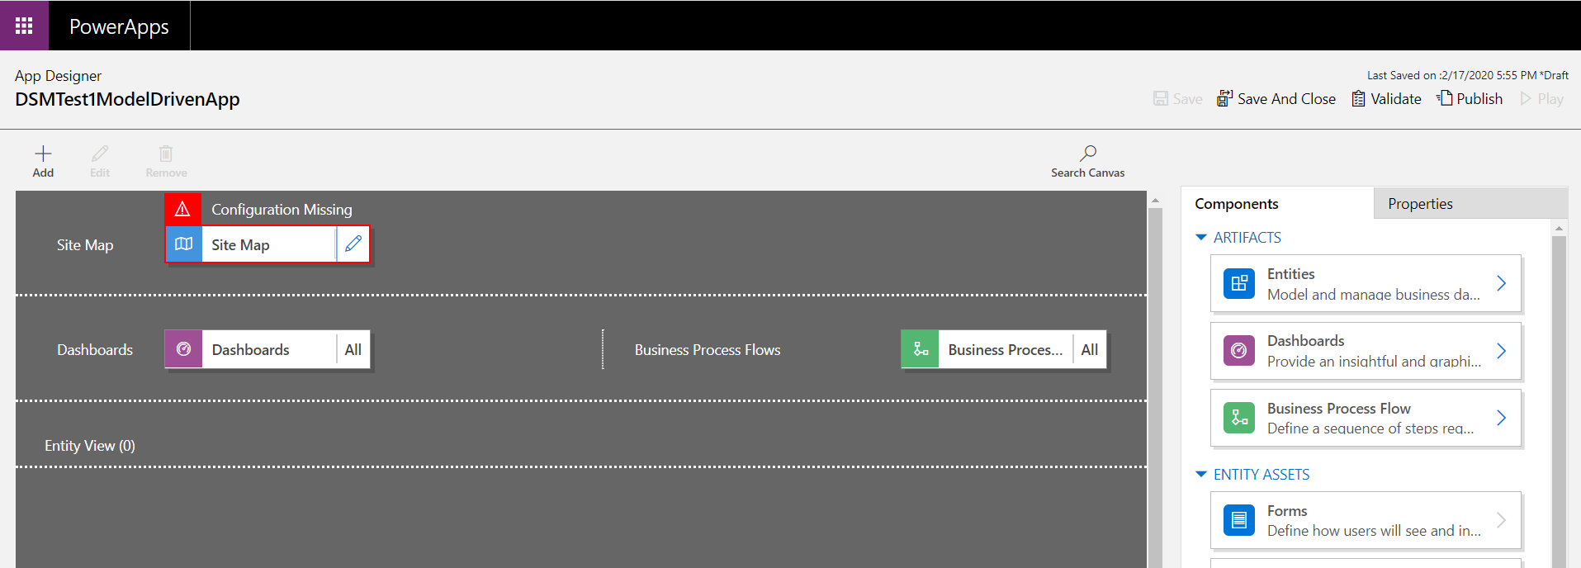
App Designer

Slide 38
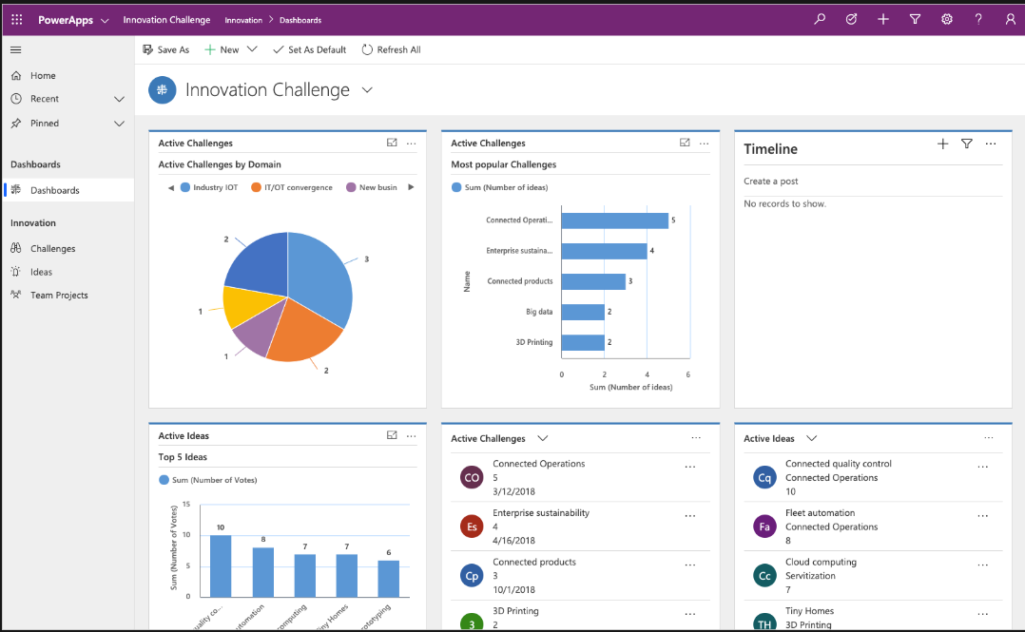

Slide 39
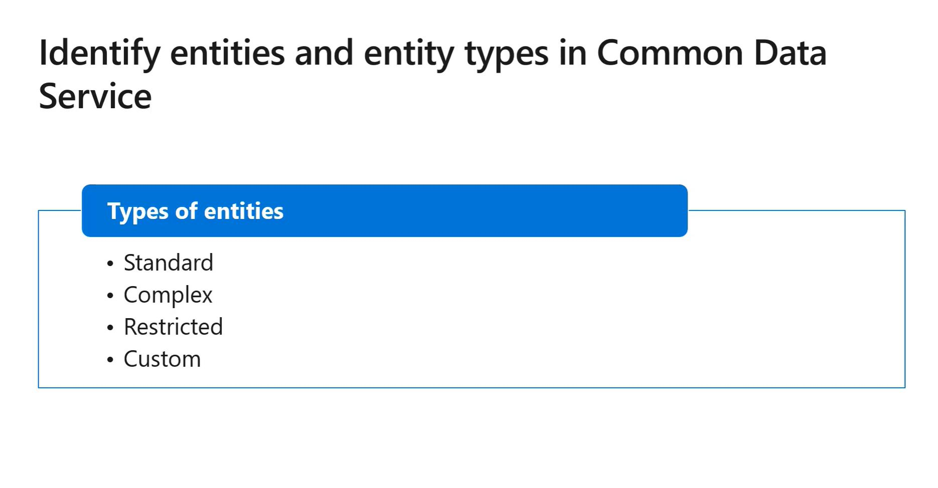

Slide 40
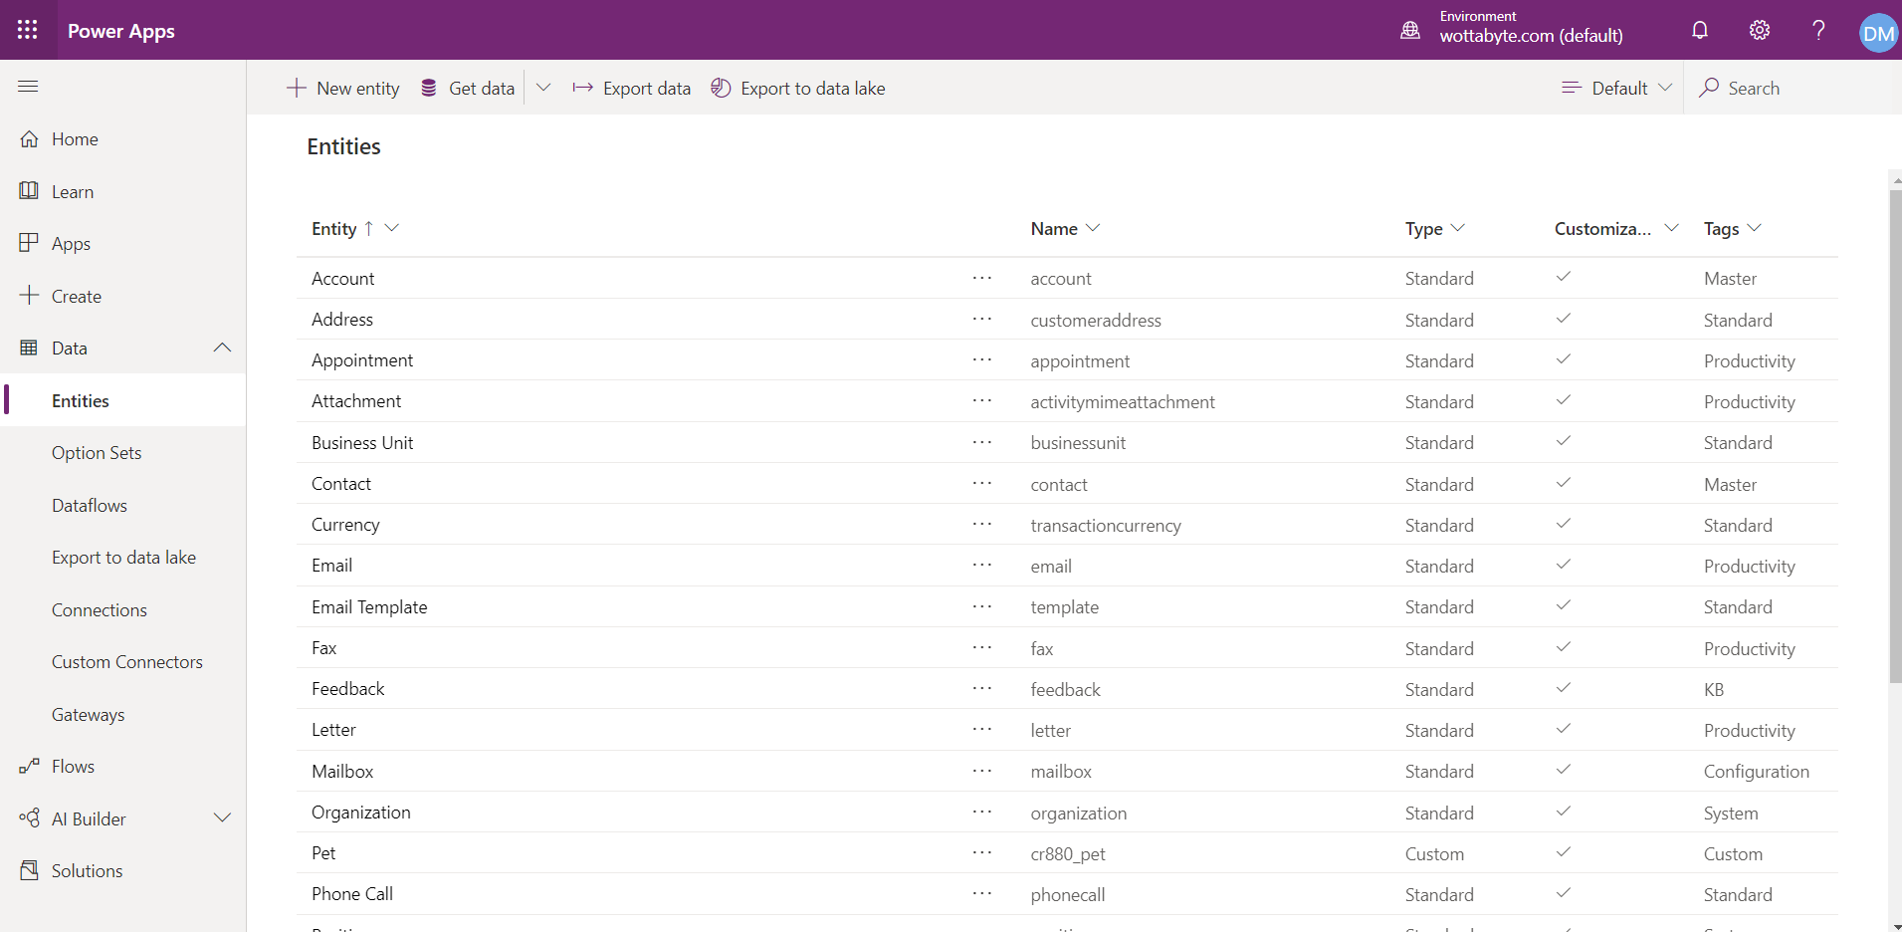
Entity

Slide 41
Comman Data service
Show entities
Edit entities
Standard entities ; Open Data Initiative (SAP, Adobe & MS)
Custom entities; why (other entities ‘complex’/’restricted’).
4TB per instance of CDS
D365 Sales, Customer Engagement, Customer Service, Talent, Marketing
Dynamics 365 Finance, Dynamic 365 Supply Chain Management, and Dynamics 365 Retail currently require the configuration of the Data Integrator to make your business data available within Common Data Service.

Slide 42
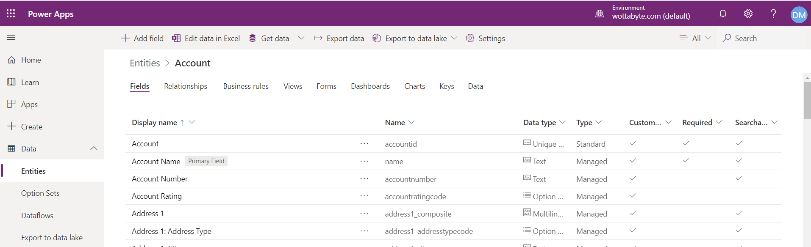
Fields, Relationships, Biz Rules, Views, Forms, Dashboards, Charts, Keys, Data

Slide 43
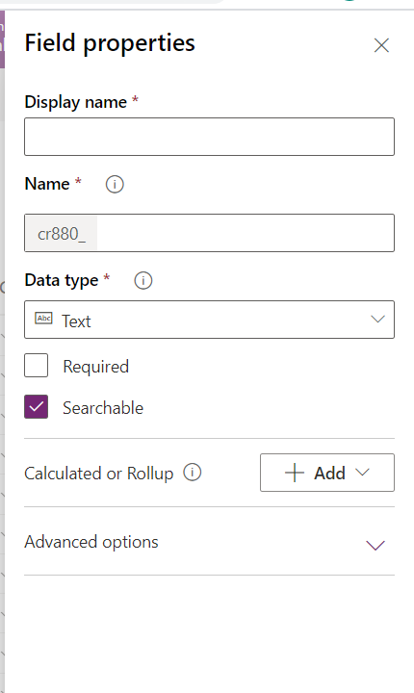
Fields

Slide 44
Fields (think calculated columns)
Add calculated fields see Calculated or Roolup use ‘+ Calculation’
ADDHOURS, ADDDAYS, ADDWEEKS, ADDMONTHS, ADDYEARS, SUBTRACTHOURS, SUBTRACTDAYS, SUBTRACTWEEKS, SUBTRACTMONTHS, SUBTRACTYEARS, DIFFINDAYS, DIFFINHOURS, DIFFINMINUTES, DIFFINMONTHS, DIFFINWEEKS, DIFFINYEARS, CONCAT, TRIMLEFT, and TRIMRIGHT.
Conditions & Action
https://docs.microsoft.com/en-us/powerapps/maker/common-data-service/define-calculated-fields

Slide 45
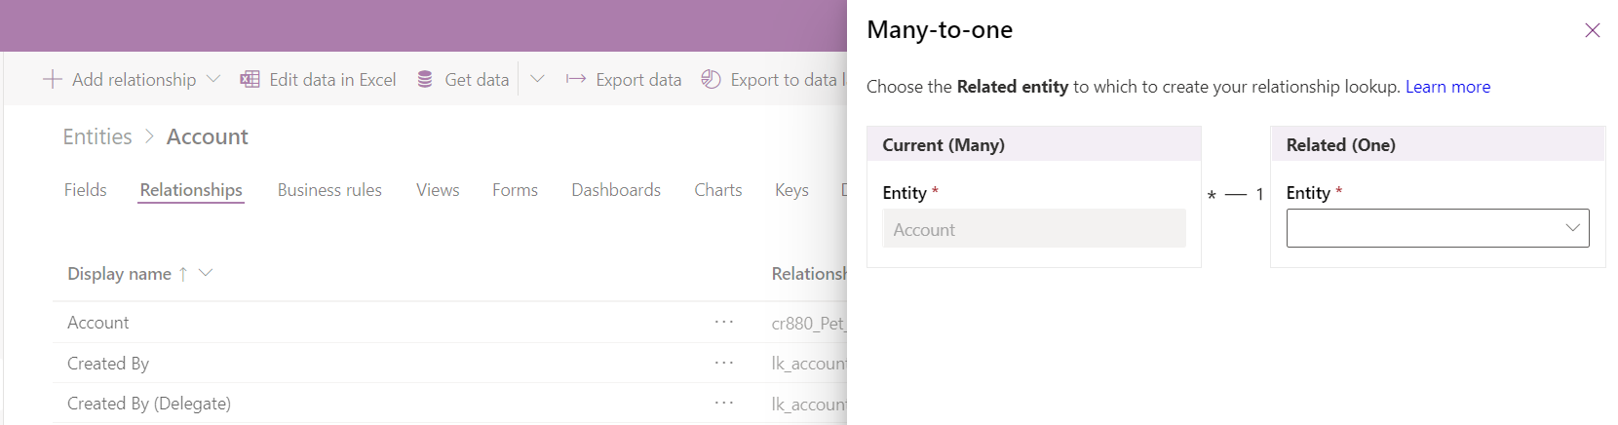
Relationships

Slide 46
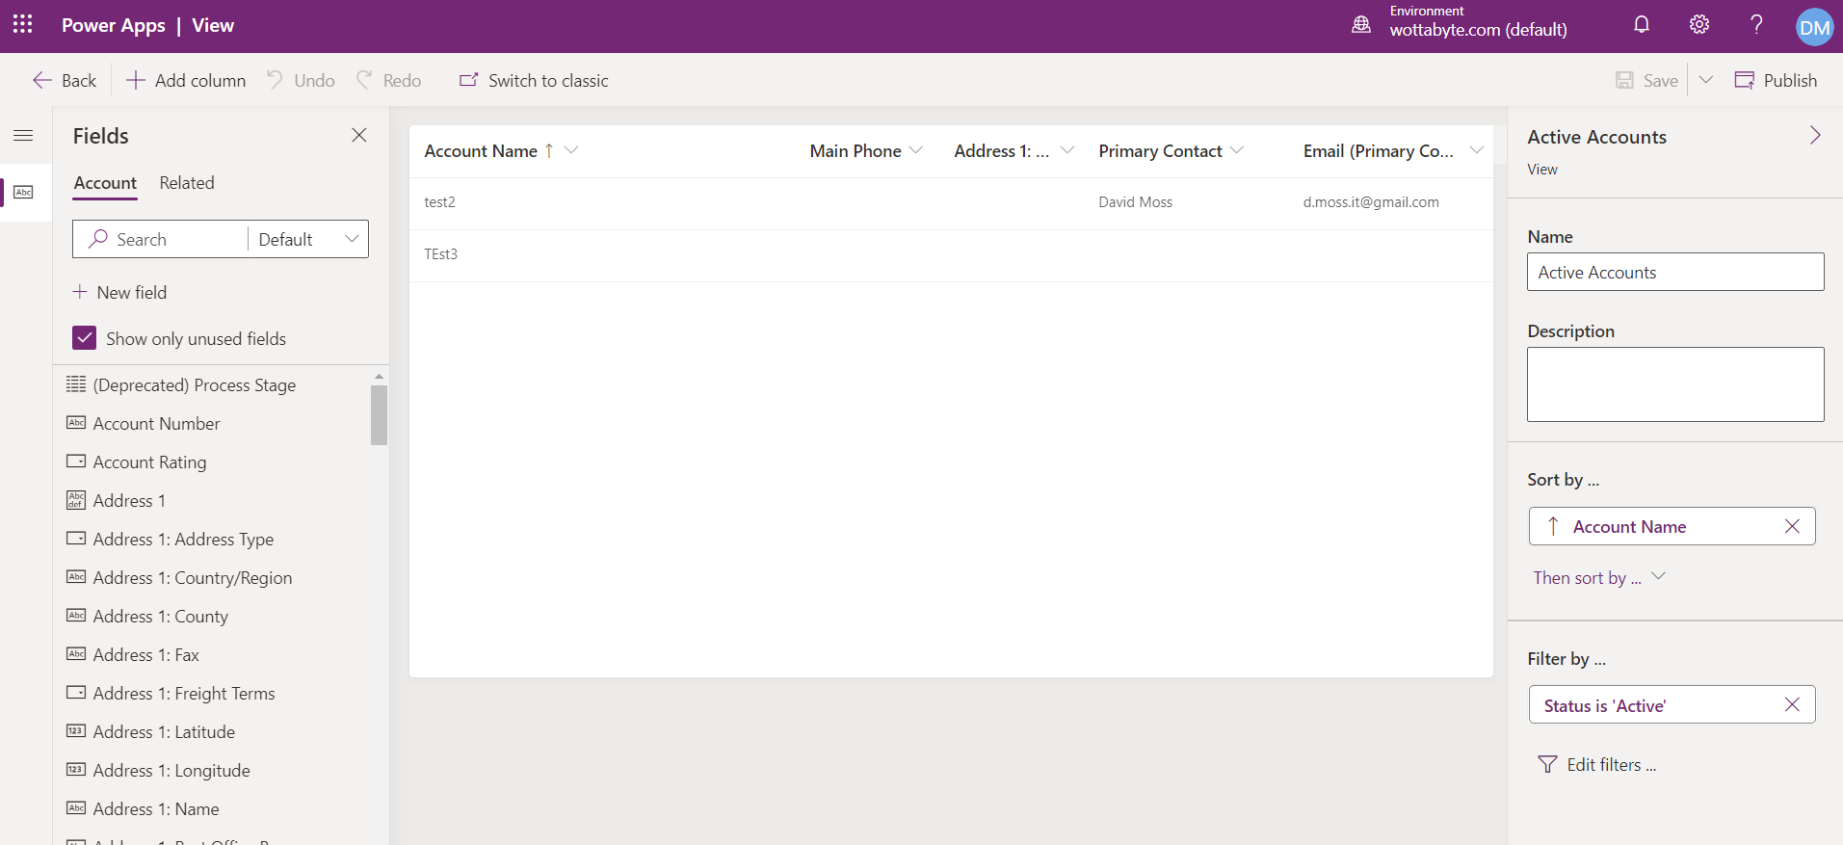
Views: SSRS Paginated Reports

Slide 47
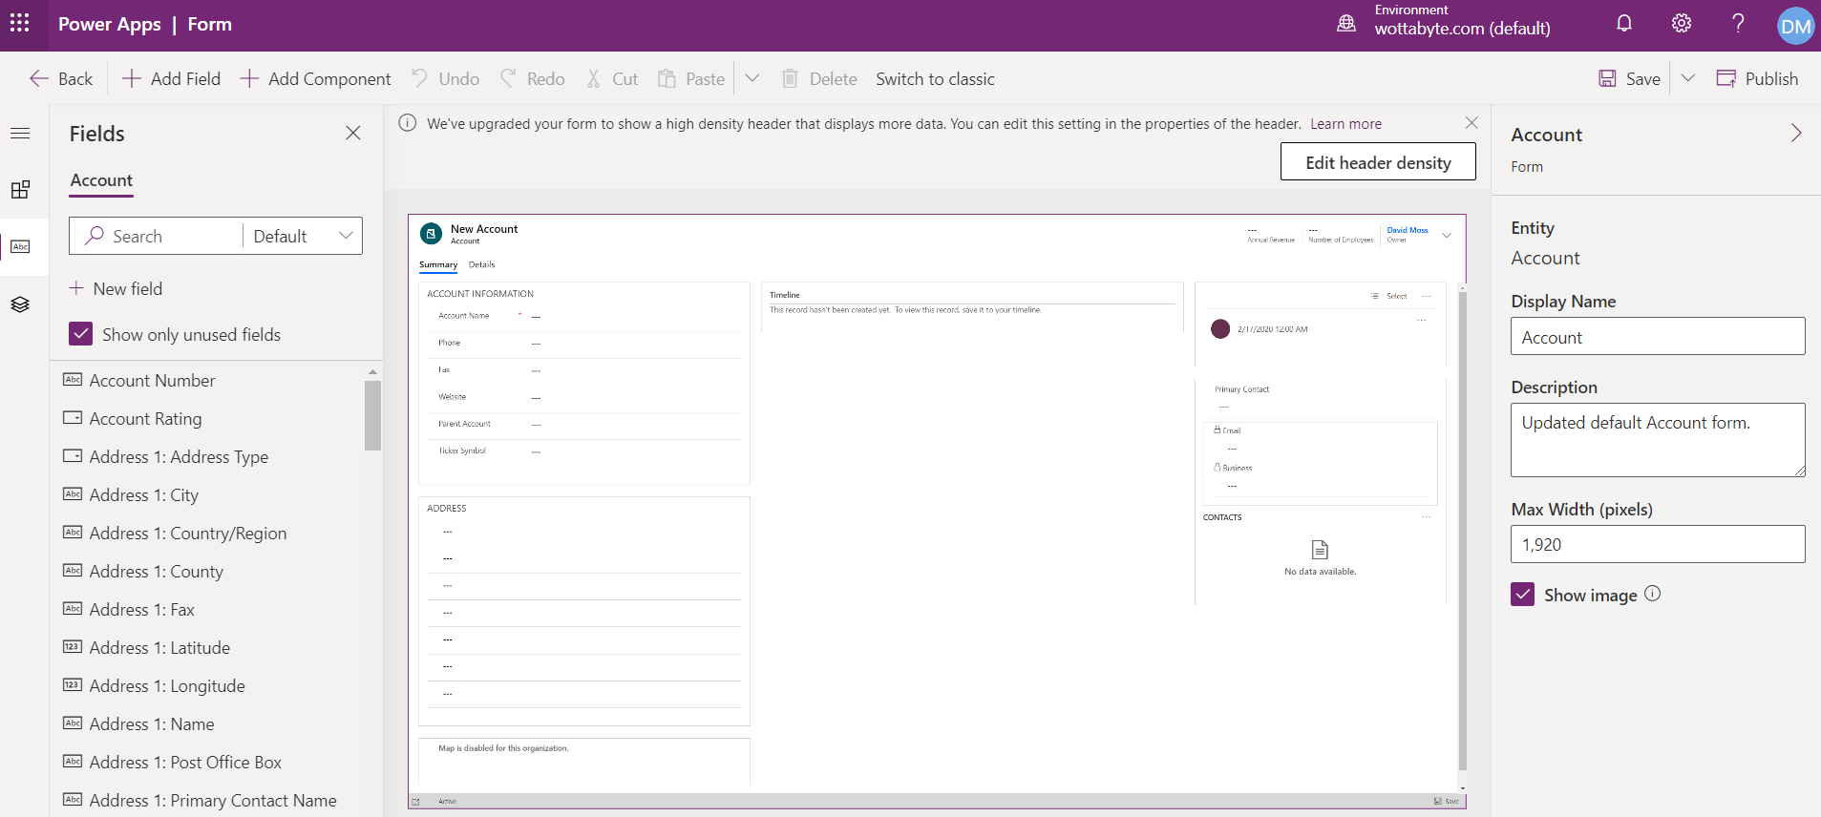
Forms

Slide 48
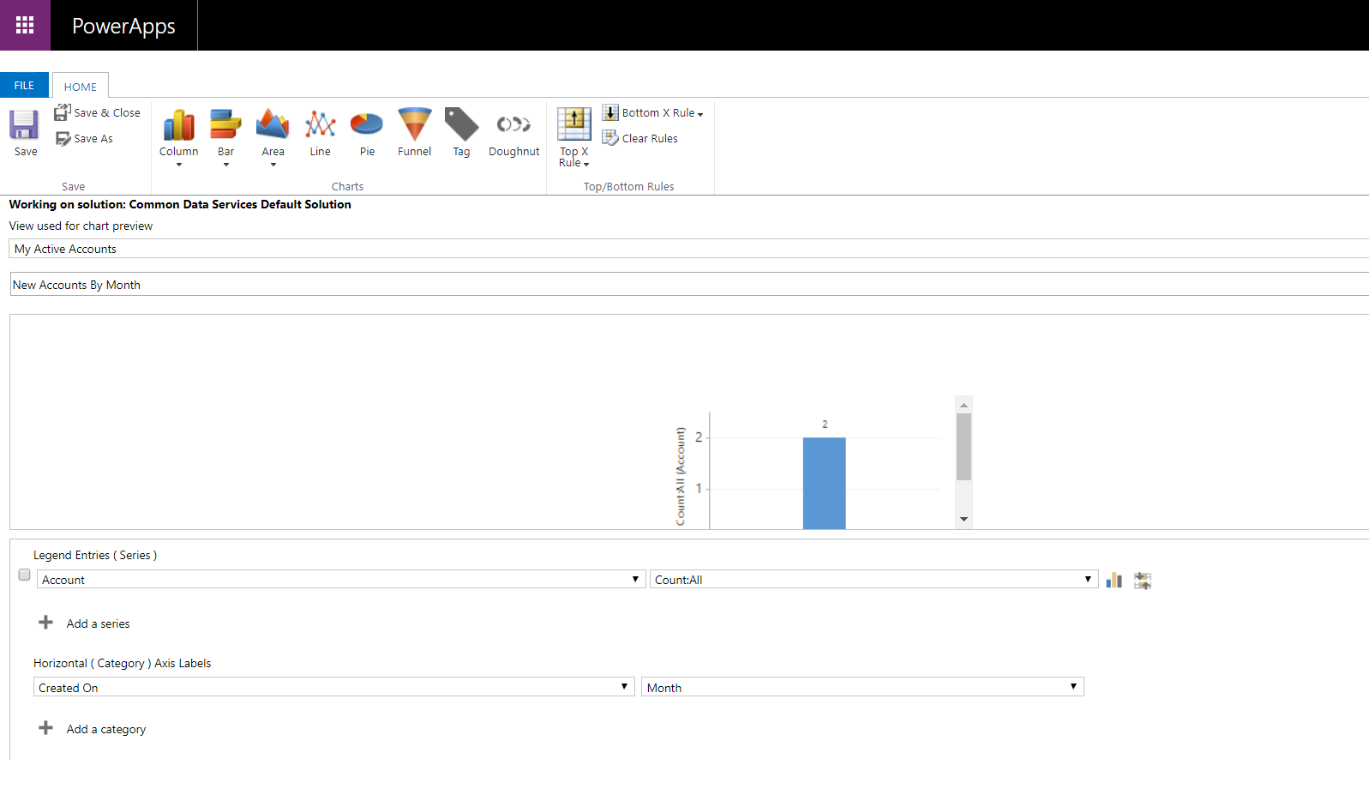
Charts

Slide 49
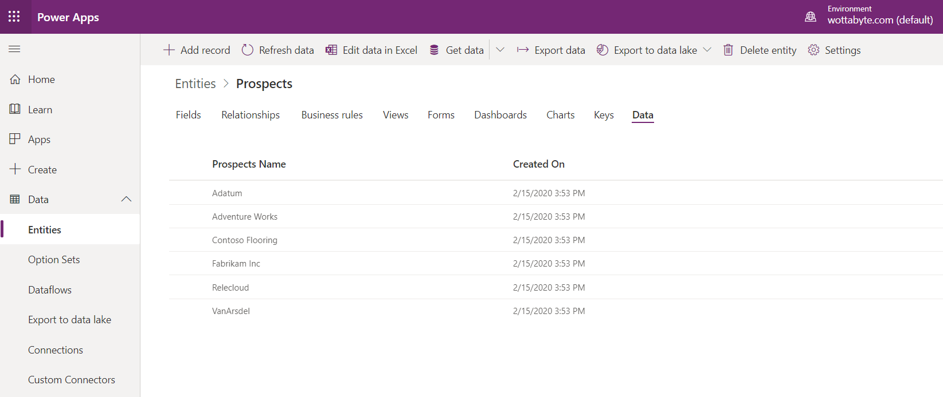
View Data in entity

Slide 50
Logic & Validation
Business Rules: conditional logic (force values on logic)
Business Process Flows: steps across top of screen
Workflows: automate business processes without a user interface.
Actions: perform operations (CrUD, assign etc..) ‘global’
Business logic with code
Also Flows see Power Automate

Slide 51
Stop. Do during next lab. Think social media.
Goto lab next slide then during lab
Take a photo of full room
Do a video promo 15 sec. Crowd shout ‘Power Platform’
All connect on LinkedIn
Attendees take photos and share on twitter, Linkedin, etc
@wottabyte #powerplatform
Share your photos on Slack

Slide 52
Lab 2: Model driven Apps
Learning Path https://docs.microsoft.com/en-gb/learn/paths/create-app-models-business-processes/
Do this Module
https://docs.microsoft.com/en-gb/learn/modules/get-started-with-model-driven-apps-in-powerapps
Student speed read unit 1 & 2
Lab do unit 3 ‘Create a model driven app’
https://docs.microsoft.com/en-gb/learn/modules/get-started-with-model-driven-apps-in-powerapps/3-create-a-model-driven-app
Lab do unit 6 ‘Exercise – Create a model driven app’
https://docs.microsoft.com/en-gb/learn/modules/get-started-with-model-driven-apps-in-powerapps/5b-create-model-driven-application

Slide 53
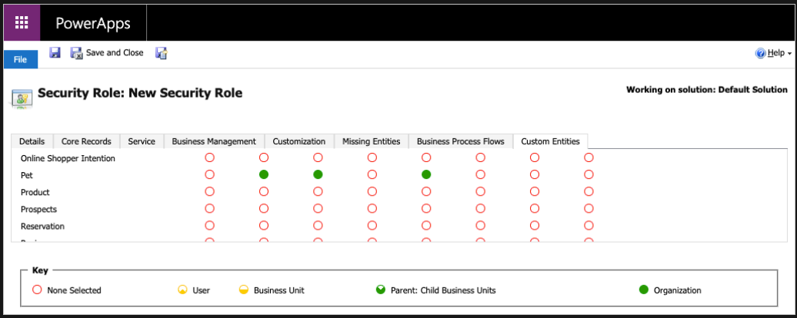
RBAC Role Based Access Control
https://docs.microsoft.com/en-gb/learn/modules/get-started-with-model-driven-apps-in-powerapps/5-control-security-when-sharing-model-driven-apps

Slide 54
Advanced Power Apps
Functions – Filter, Match, Distinct, Math functions https://docs.microsoft.com/en-gb/powerapps/maker/canvas-apps/formula-reference#s
Formulas; https://docs.microsoft.com/en-gb/powerapps/maker/canvas-apps/formula-reference
https://docs.microsoft.com/en-gb/powerapps/maker/canvas-apps/working-with-formulas
Intelligent controls – camera, bar code scanner, GPS
AI integration

Slide 55
Power Apps logic & validation / Business Logic
Business rules in model driven apps (Business Rule designer) https://docs.microsoft.com/en-gb/powerapps/maker/model-driven-apps/create-business-rules-recommendations-apply-logic-form
Business rules for entities (Business Rule designer) https://docs.microsoft.com/en-us/powerapps/maker/common-data-service/data-platform-create-business-rule
Business process flows (Biz Process flow designer) https://docs.microsoft.com/en-us/power-automate/business-process-flows-overview
Workflows (Workflow designer) https://docs.microsoft.com/en-us/power-automate/workflow-processes
Actions (Process designer) https://docs.microsoft.com/en-us/power-automate/actions
Flows (Power Automate) https://docs.microsoft.com/en-gb/powerapps/maker/model-driven-apps/guide-staff-through-common-tasks-processes#flows

Slide 56
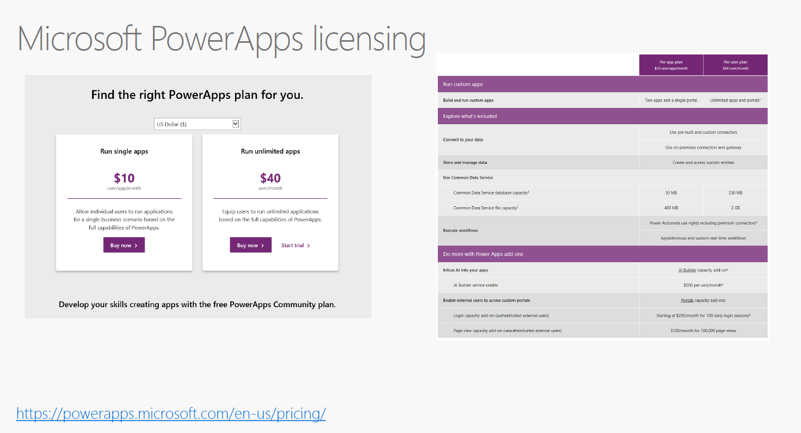

Slide 57
Agenda
5th Feb: Intro Power Platform, PL-900, onboard, 1st app & CDS
19th Feb: Power Apps
4th March: Power Automate
25th March: Power BI
8th April: Power Platform summary; practice exam

Slide 58
Power Automate Power Platform PL-900
Microsoft Store Oxford Circus
Wednesday 4th March 2020
Presenter David Moss
Head of Data & AI @ Wottabyte

Slide 59
Agenda
5th Feb: Intro Power Platform, PL-900, onboard, 1st app & CDS
19th Feb: Power Apps
4th March: Power Automate
25th March: Power BI
8th April: Power Platform summary; practice exam

Slide 60
Todays agenda
Why we are here PL-900
3 quick exam questions to test audience.
Introduction to Power Automate
Creating Flows
Building complex flows with Power Automate
Using the Admin center to manage environments and data policies in Power Automate

Slide 62
36
60

Slide 63
https://docs.microsoft.com/en-us/learn/certifications/exams/pl-900

Slide 64
DA-100 Data Analyst
Analyzing Data with Power BI
https://docs.microsoft.com/en-us/learn/certifications/exams/da-100
2nd April 2020
Replaces 70-778 do before 30/6/2020
https://www.microsoft.com/en-us/learning/exam-70-778.aspx
Microsoft Certified : Data Analyst Associate

Slide 65
3 exam style questions
In WB browser https://www.mentimeter.com/app
See 3b

Slide 66
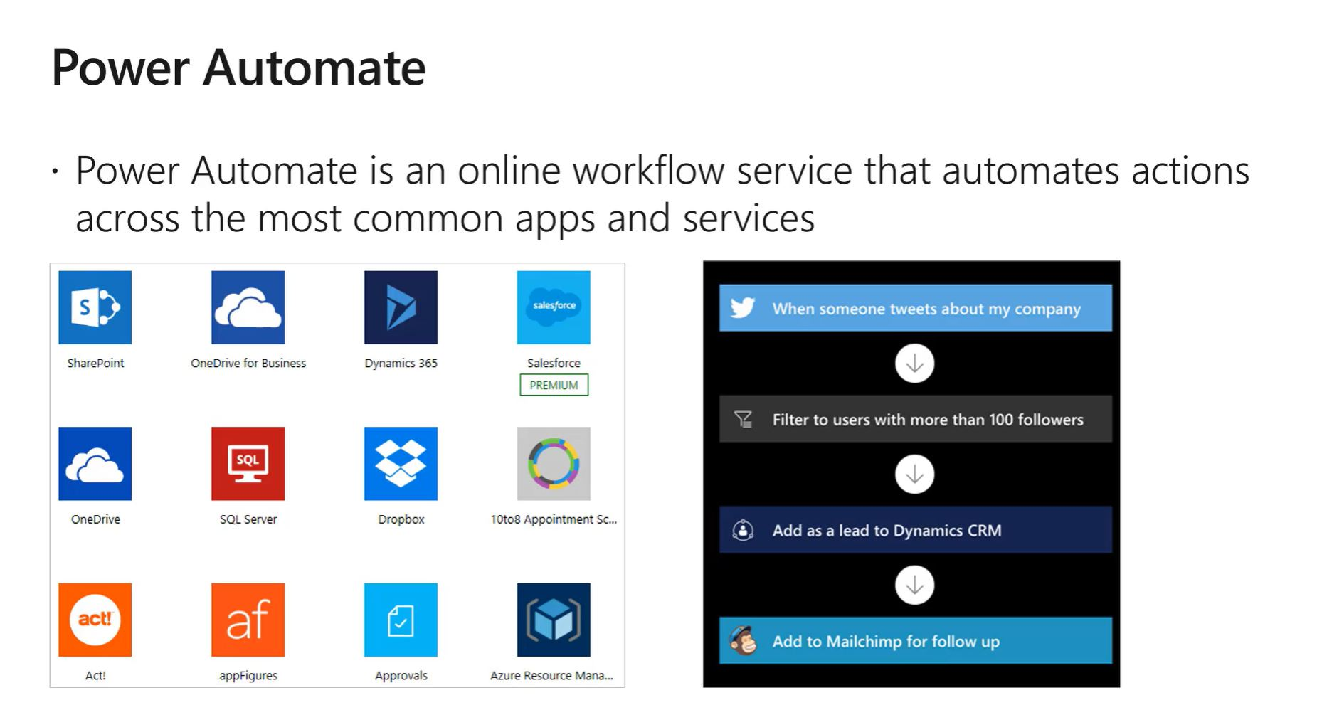

Slide 67
flow.microsoft.com
Navigate way round the user portal
Pricing https://emea.flow.microsoft.com/en-us/pricing/
/User=$15 , /flow=$500, /AIBuilder=$500

Slide 68
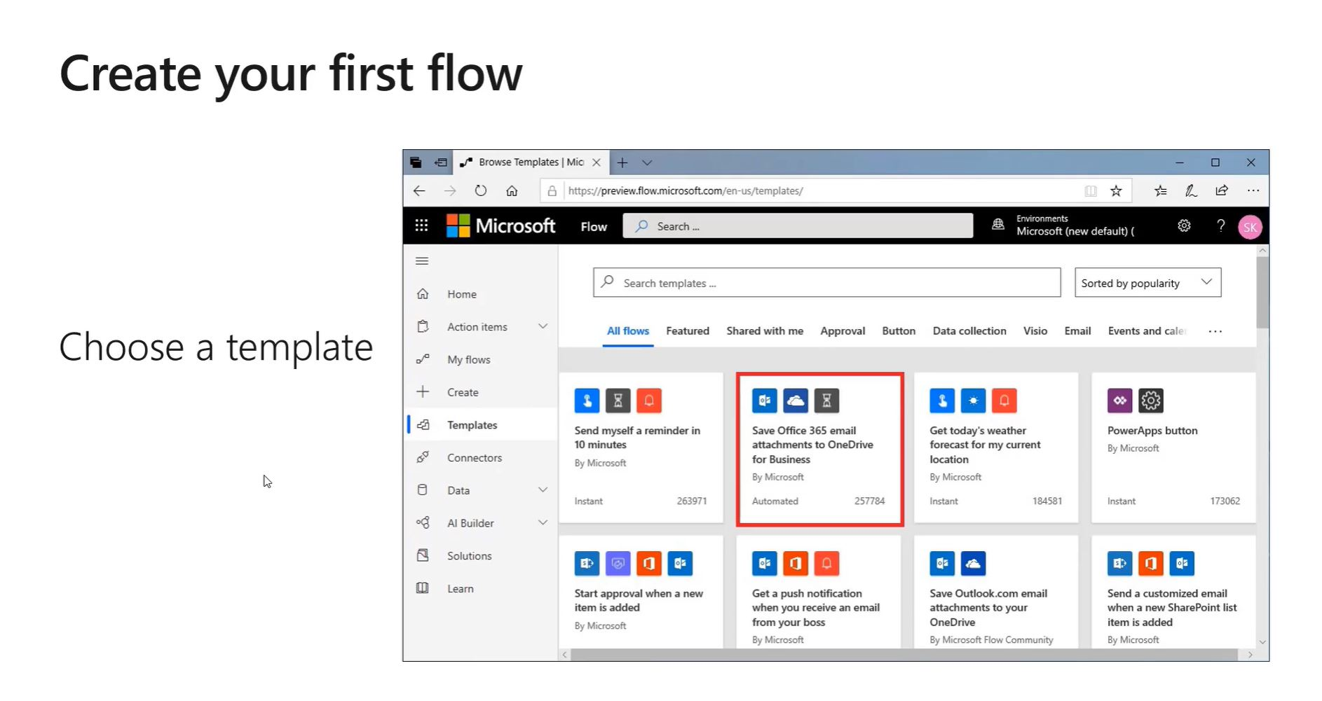

Slide 69
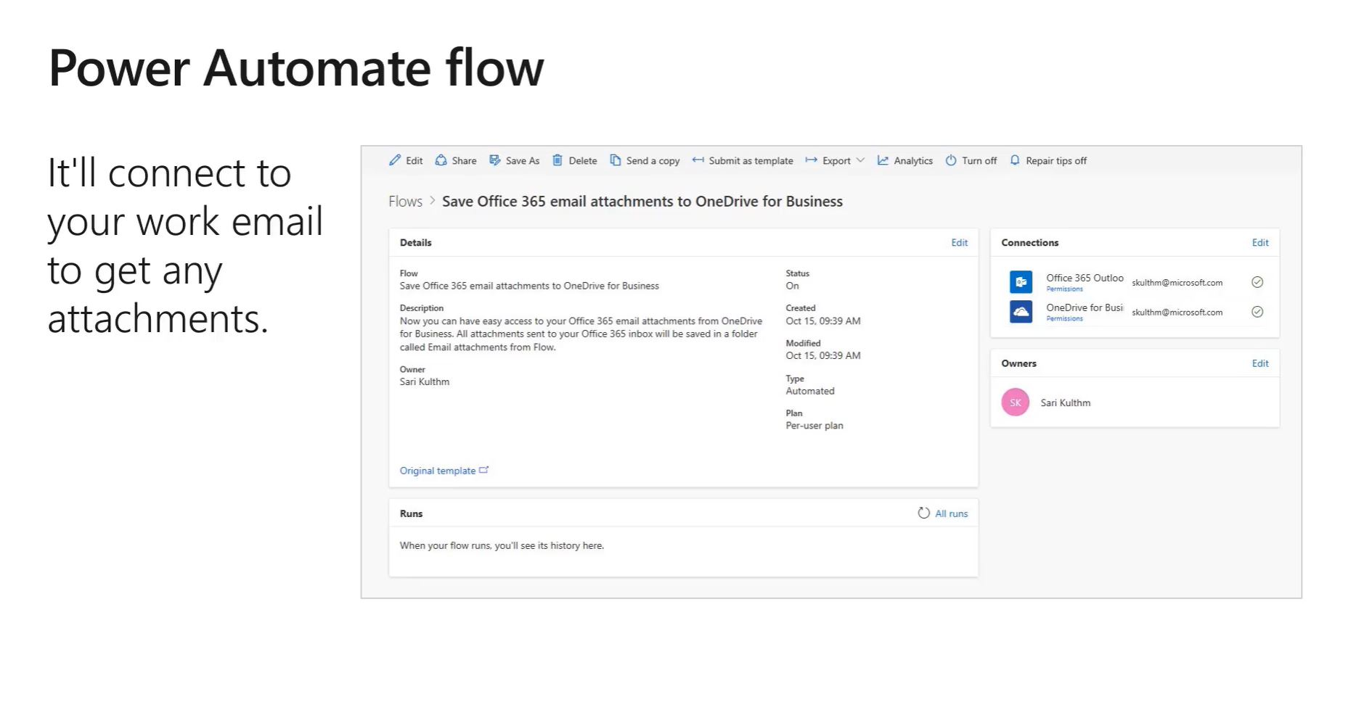

Slide 70
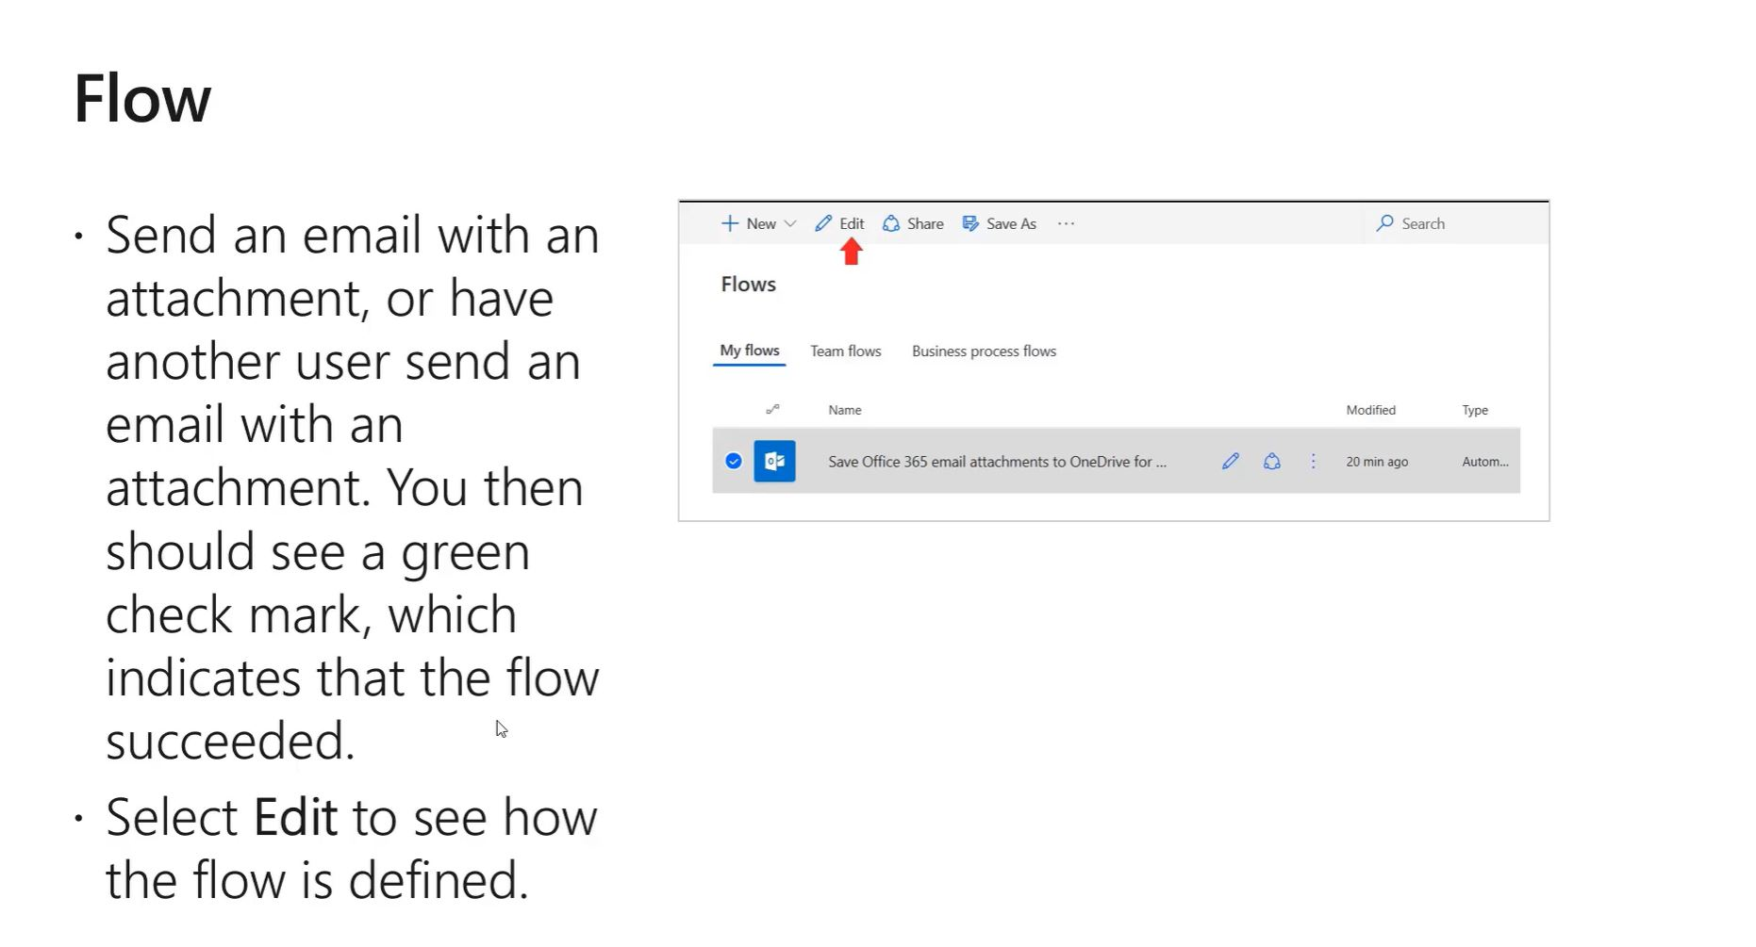

Slide 71
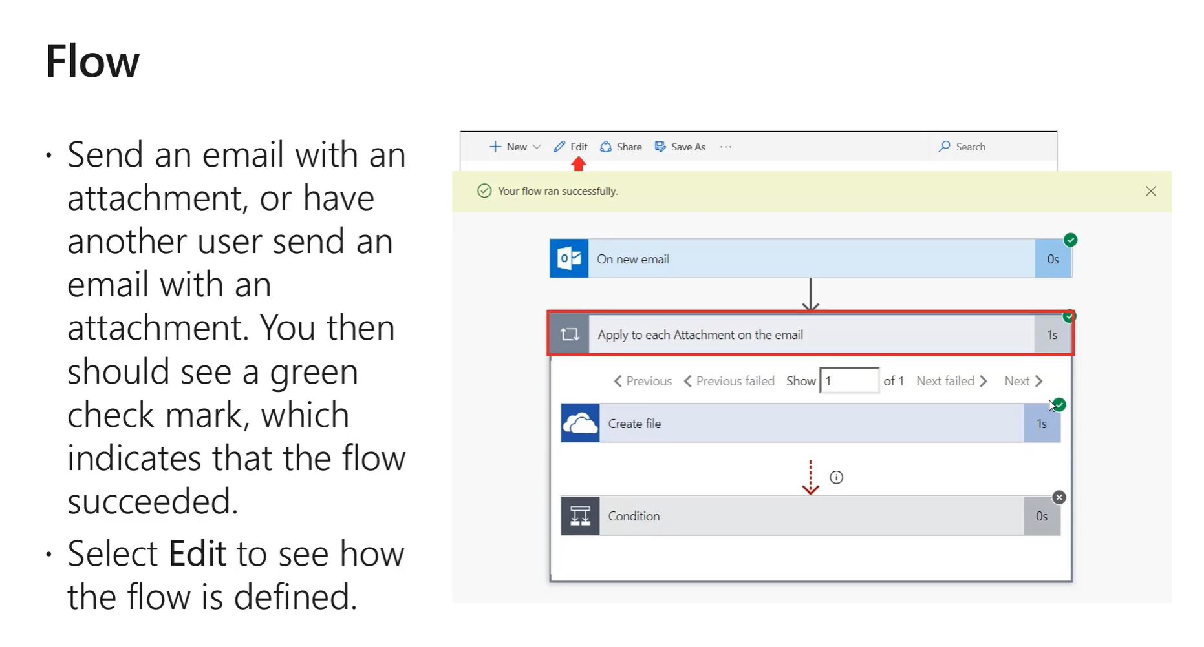

Slide 72
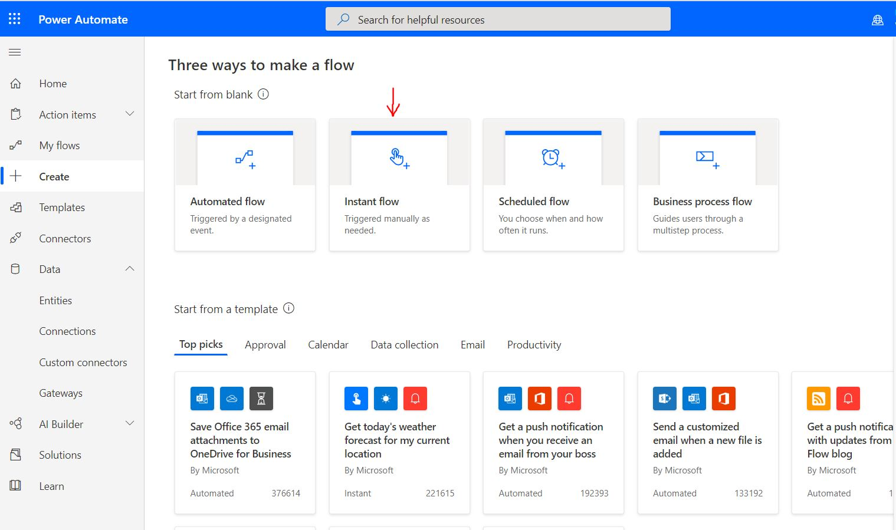

Slide 73
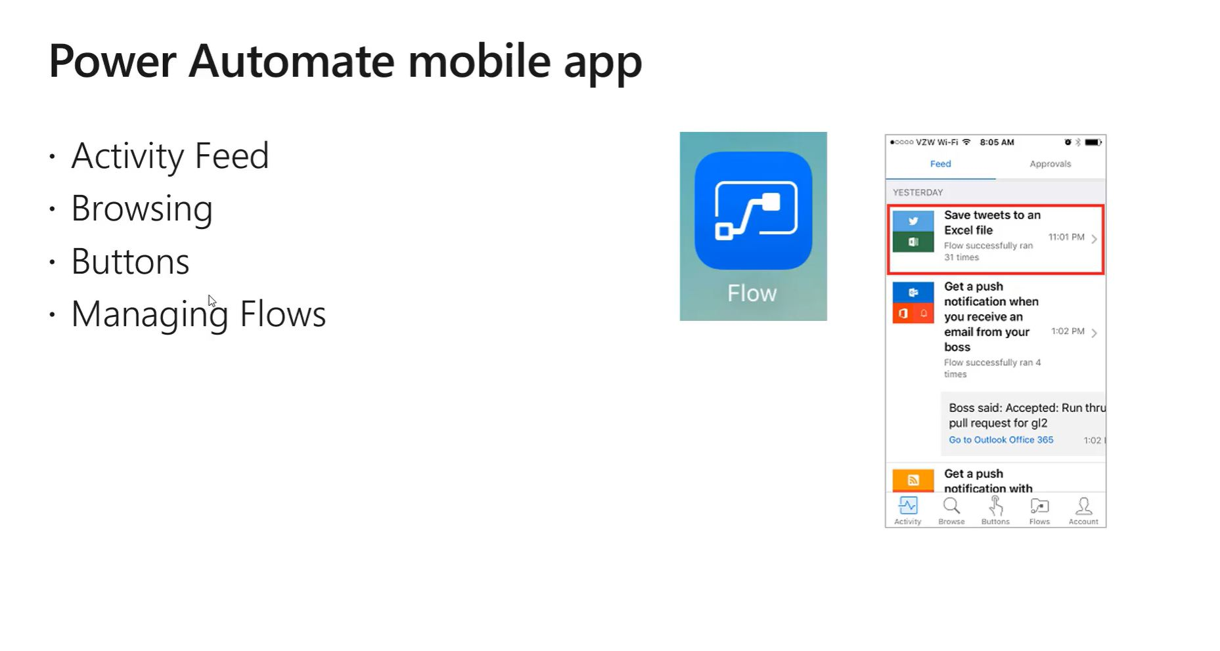

Slide 74
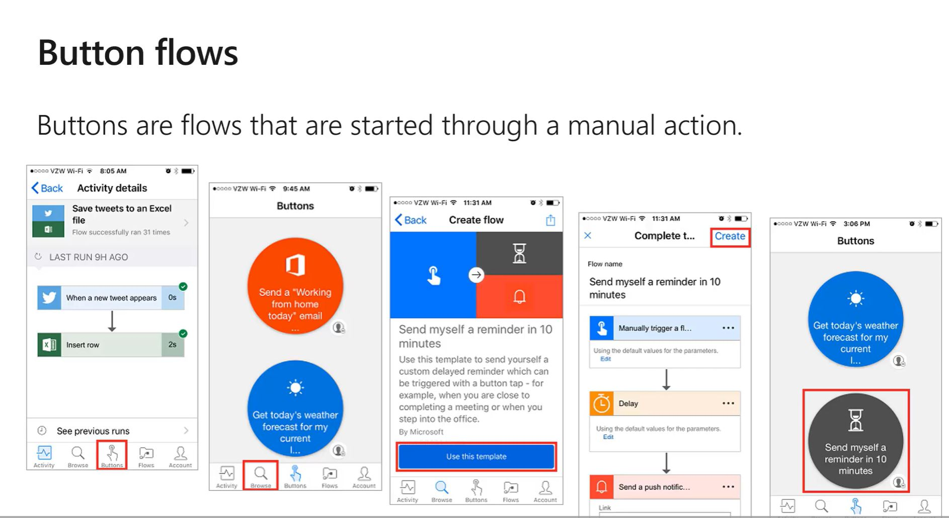

Slide 75
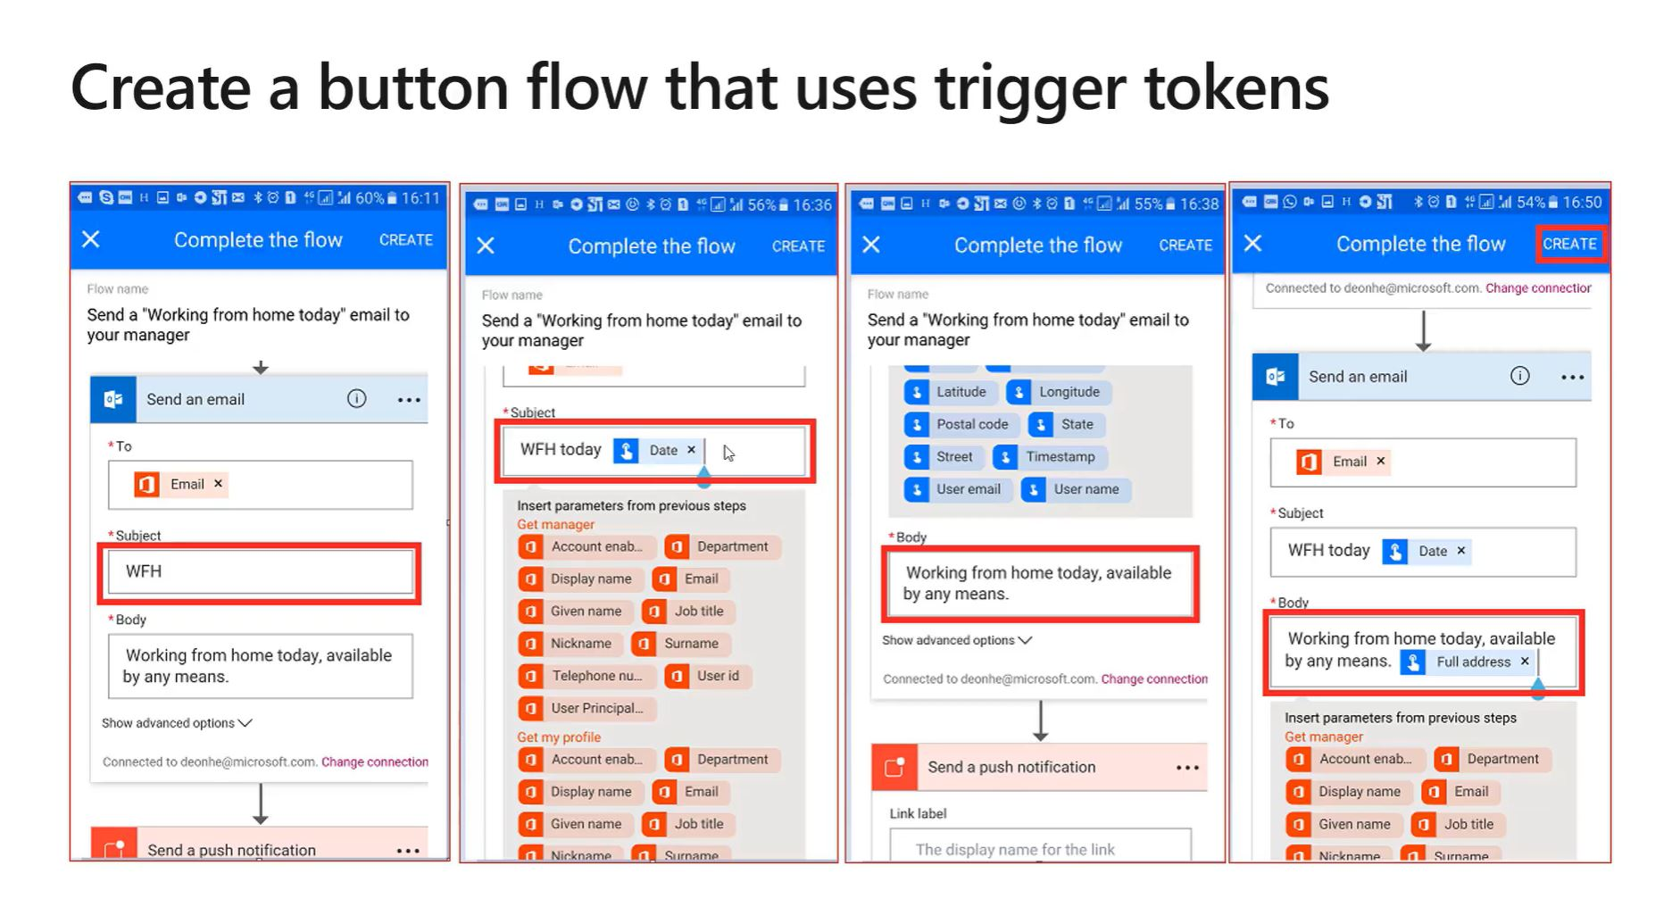

Slide 76
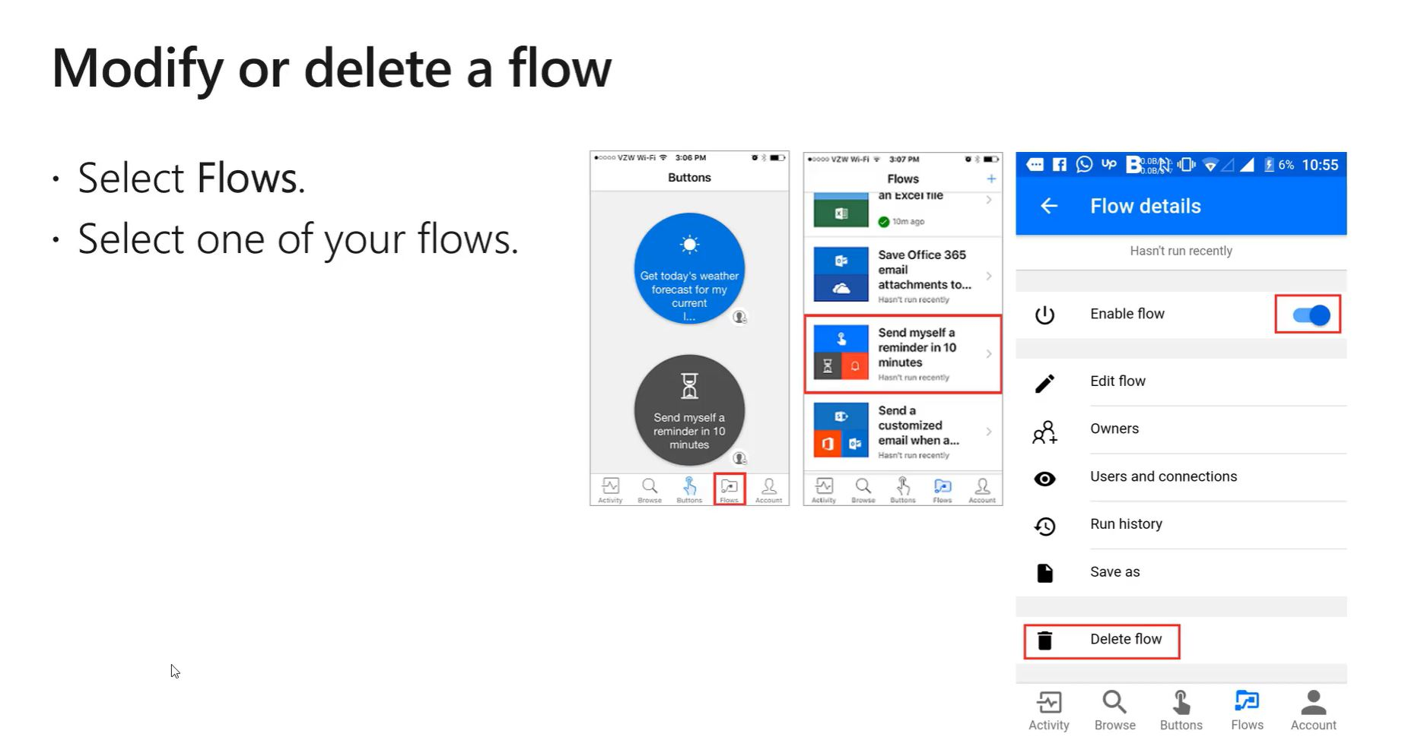

Slide 77
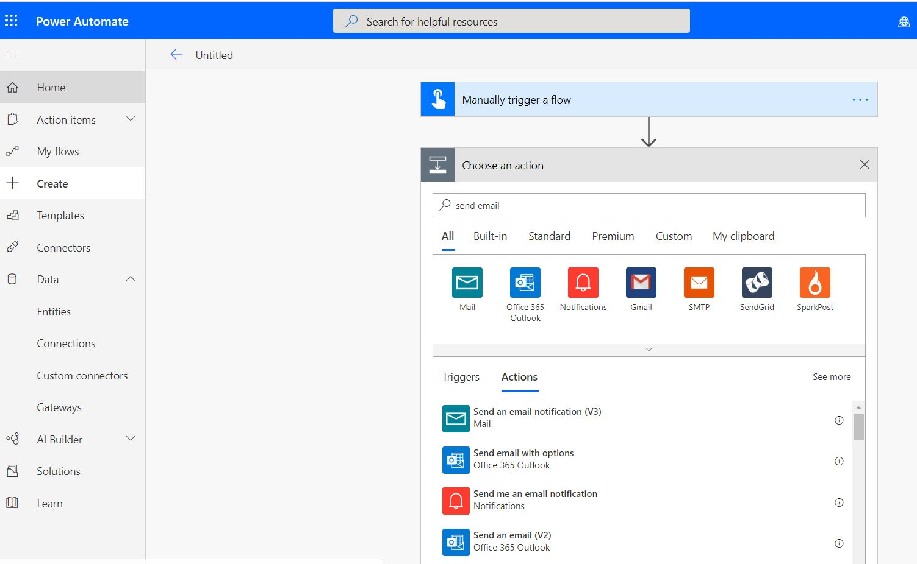
Build a button WFH to Boss
Create Instant mobile button (portal or mobile app)
Send email to boss
test

Slide 78
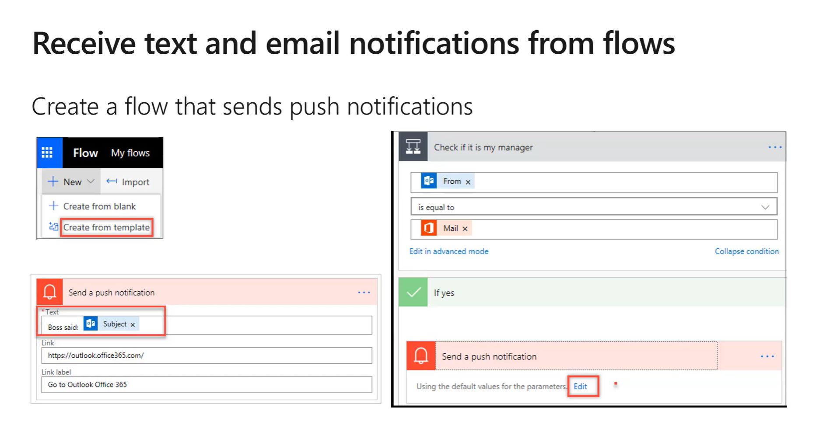

Slide 79
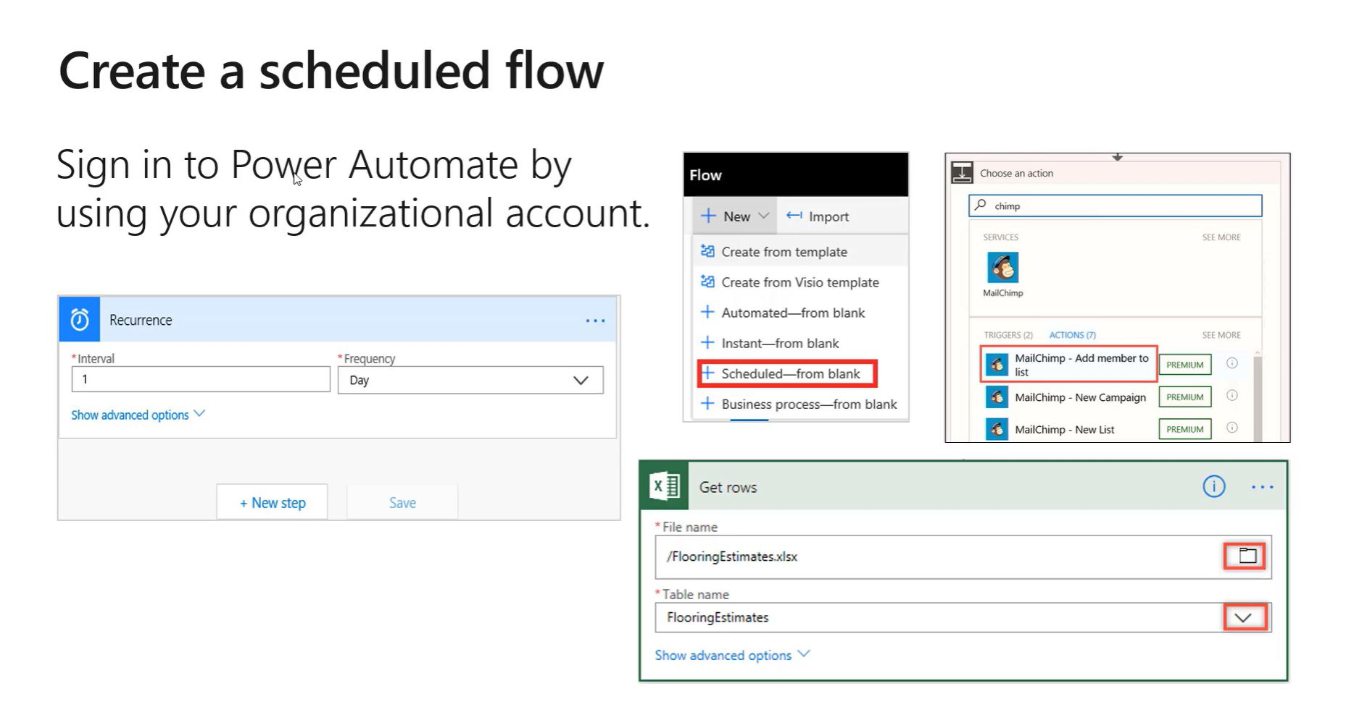

Slide 80


Slide 81


Slide 82


Slide 83


Slide 84
Power Automate Learn PP Fundamentals
Check Progress
How many built flow from ‘Power Platform Fundamentals” see module https://docs.microsoft.com/en-us/learn/modules/build-automated-solution/index
Unit 3: Build an approval request
Unit 4 : Build a Business Process Flow
Get class to do now if needed max 10 mins. Set clock countdown.

Slide 85


Slide 86


Slide 87


Slide 88


Slide 89


Slide 90


Slide 91


Slide 92


Slide 93


Slide 94


Slide 95


Slide 96


Slide 97


Slide 98


Slide 99


Slide 100


Slide 101


Slide 102


Slide 103


Slide 104


Slide 105


Slide 106


Slide 107
Power Automate Learn PP Fundamentals
Check Progress
How many built flow from ‘Power Platform Fundamentals” see module https://docs.microsoft.com/en-us/learn/modules/build-automated-solution/index
Unit 3: Build an approval request
Unit 4 : Build a Business Process Flow
Get class to do now if needed max 10 mins. Set clock countdown.

Slide 108
Keywords
Trigger (button, automated, recurrence) (poll,push)
Action
Dynamic content
Team Flows Unit 8 https://docs.microsoft.com/en-gb/learn/modules/get-started-flows/8-flow-team-flows
Embedded connections , ‘Other’.
AI Builder https://flow.microsoft.com/en-us/ai-builder/
Button trigger tokens like GPS location

Slide 109
Power Automate Mobile app
Activity Feed
Browsing
Buttons
Managing Flows

Slide 110
Flow fix
401/403 Unauthorised
400/404 Bad request (not found)
500/502 Temporary error
Data usage – goto to admin centre
Usage limits
Per a/c 250 flows, 15 custom connectors, 20 APIs
Gateway in default environment

Slide 111
Lab 3a units are restricted as you do not have an O365 license !!!
Learning Path Lab https://docs.microsoft.com/en-gb/learn/paths/automate-process-power-automate/
Module ‘Get started with Power Automate’ https://docs.microsoft.com/en-gb/learn/modules/get-started-flows/
Unit 2 NO for O365 Save Office 365 email attachments to OneDrive for Business
Unit 3 Button good quick win on mobile as well.
Unit 4 No for O365 manager configuration Get a push notification when you receive an email from your boss.
Unit 5 No copy files
Unit 6 cud do from Sharepoint not Excel (licenses)
Unit 7 good twitter to email (or SMS) or notification.

Slide 112
Lab3b
https://docs.microsoft.com/en-gb/learn/paths/automate-process-power-automate/
Module 2 : Build more complex flows with Power Automate https://docs.microsoft.com/en-gb/learn/modules/build-more-flows/
Unit 5 is good quick win Button with location (Trigger tokens)
Unit 9 good for Azure sql db
Unit 10 Power Apps, flow & Sharepoint
Unit 11 Business Process flows & unit 12 with Conditions (lead & loan).

Slide 113
Lab 3c :
https://docs.microsoft.com/en-gb/learn/paths/automate-process-power-automate/
Module 3 : Use the admin centre to mange environments and data policies in Power Automate https://docs.microsoft.com/en-gb/learn/modules/administer-flows
Share button ‘provided by user’ credentials similar to PBI gateway settings.

Slide 114
More advanced
MS Learn for
MB-200
MB-400
Eg Introduction to developing with Power Platform
https://docs.microsoft.com/en-gb/learn/paths/intro-developing-power-platform/

Slide 115
Power BI Power Platform PL-900
remote – online - WFH
Wednesday 25th March 2020
Presenter David Moss
Head of Data & AI @ Wottabyte

Slide 116
Agenda
5th Feb: Intro Power Platform, PL-900, onboard, 1st app & CDS
19th Feb: Power Apps
4th March: Power Automate
25th March: Power BI
8th April: Power Platform summary; practice exam

Slide 117








David Moss
Azure AI & BI, D365 & Power Platform Solutions
Delivering end to end Azure AI & BI hybrid solutions with a passion for D365, Power Platform & Power BI reports across IoT, e-commerce, telcos, fintech & manufacturing verticals.
MVP Data Platform
Since 2017 awarded MVP for my community contributions.
Leader of Power BI meetup user groups in London and Manchester.
Community & conference presenter.
ACMA, CGMA Accountant
@wottabyte
A qualified ACMA accountant all my career which keeps me commercially aware & business facing partner on D365 F&O projects.
wottabyte
www.wottabyte.com
Notes:
Hand out cards & stickers

Slide 118
Todays agenda
Why we are here PL-900
3 quick exam questions to test audience.
Introduction to Power BI – full demo and workflow
Power BI key software components
3 more quick exam questions
Connect & Consume data
Building Power BI reports & dashboards
Final exam test questions.
Next session agenda

Slide 120
36
60

Slide 121
https://docs.microsoft.com/en-us/learn/certifications/exams/pl-900

Slide 122
DA-100 Data Analyst
Analyzing Data with Power BI
https://docs.microsoft.com/en-us/learn/certifications/exams/da-100
2nd April 2020
Replaces 70-778 do before 30/6/2020
https://www.microsoft.com/en-us/learning/exam-70-778.aspx
Microsoft Certified : Data Analyst Associate
Microsoft Certified : Power Platform Fundamentals

Slide 123

Notes:
Power BI Dashboard

Slide 124
3 exam style questions
www.powerbi.com
In WB browser https://www.mentimeter.com/app
Do quiz 4a

Slide 125

Notes:
Power BI Dashboard & Power BI Mobile App

Slide 126

PBI Desktop, PBI Service, PBI Mobile apps

Slide 127

Notes:
Power BI Desktop … Installed ?

Slide 128


Transform data to insights
Get your data
Analyze
Visualize
Publish
Collaborate

Slide 129
















Easily connect, clean, and mashup data
Get your data
Connect to any data sources on-premises and cloud
Shape, transform, and clean data
Connect live to any data source
Prep your data using familiar Power Query experience
Extend self-service prep to Azure Data Lake Storage

Slide 130











Power BI data sources

Slide 131

Build powerful models and flexible measures
Analyze
Create model automatically
Simplified point and click analysis with Quick Measures, Clustering, and Binning
Create powerful measures with familiar DAX formulas

Slide 132

Create stunning interactive reports
Visualize
Choose from limitless visualization options
Visualizations are interactive and link together
Use bookmarks and custom navigation to bring your data story to life

Slide 133




Visualize in the context of your business
Notes:
When you embed Power BI into your application, you get to choose how to tell your story and represent your data to your users. It isn’t just bar charts and line graphs. You can even embed a fish tank visual if that suits your needs.
Okay…
So let’s get out of Power Point for a bit and I’ll show you the Power BI Embedded playground. The playground is where you’ll be able to see every single front-end feature we deploy into our service. I want to quickly show you two things: Q&A and insights to actions. These are two features you can enable for your customers. But as I mentioned, every front-end feature is available for you and your team to explore and try out.

Slide 134

Share insights with others
Publish
Publish interactive or paginated reports to the cloud or on-premises
Automatic data refresh, so your reports are always up to date
Package your reports in apps for easy consumption and control
Manage your analytics content with admin and governance tools

Slide 135




Empower your organization
Collaborate
Provide insights on any device
Use Q&A to automatically discover insights
Deliver insights in other user flows like Teams and SharePoint
Connect live to your models in Excel and Power BI Desktop

Slide 136





Stay connected to your data on the go

Slide 137




Deliver insights through
Excel
Visio
SharePoint
Teams
PowerApps
Dynamics 365
SaaS apps

Slide 138


February 2020
A Leader in
Analytics & BI Platforms*
*Gartner “Magic Quadrant for Analytics and Business Intelligence Platforms,” by Cindi Howson, James Richardson, Rita Sallam, Austin Kronz, 11 February 2019
The above graphics were published by Gartner, Inc. as part of a larger research document and should be evaluated in the context of the entire document. The Gartner document is available upon request from Microsoft. Gartner does not endorse any vendor, product or service depicted in its research publications, and does not advise technology users to select only those vendors with the highest ratings or other designation. Gartner research publications consist of the opinions of Gartner's research organization and should not be construed as statements of fact. Gartner disclaims all warranties, expressed or implied, with respect to this research, including any warranties of merchantability or fitness for a particular purpose. GARTNER is a registered trademark and service mark of Gartner, Inc. and/or its affiliates in the U.S. and internationally and is used herein with permission. All rights reserved.

Slide 139
Power BI family
Author
Share and collaborate
Large scale deployments
Power BI Desktop
Power BI Pro
Power BI Premium
Free data analysis and report authoring tool
Cloud-based modern business analytics solution
Dedicated capacity for increased performance

Slide 140
Power BI family
Author
Share and collaborate
Large scale deployments
Power BI Desktop
Power BI Pro
Power BI Premium
Free data analysis and report authoring tool
Cloud-based modern business analytics solution
Dedicated capacity for increased performance
Deployment option 1
Deployment option 2

Slide 141
www.powerbi.com > Pricing
Power BI free user
Power BI Pro : $10/user/month
Power BI Premium : P1 $5000/capacity/month
Office 365 E5 : Power BI included
Power BI desktop : free
https://powerbi.microsoft.com/en-us/pricing/

Slide 142
Power BI: analytics for every organization Unified self-service & enterprise BI platform
Interactive data visualizations and paginated reports
Web
On-premises
Cloud data
Open and extensive ecosystem with native Microsoft and third-party integrations
Mobile
AI innovations
Embedded
Big data analytics through Azure Data Services
“…”
On-premises data
Secure, compliant, enterprise-grade platform
Notes:
Core update

Slide 143

It’s easy to get started… PowerBI.com

Slide 144
Demo
Portal Power BI Desktop then powerbi.com

Slide 145

DIAH Demo
Notes:
DIAH demo sample

Slide 146
Power BI innovation areas
Self-service BI/collaboration
Unified self-service and enterprise BI
Pervasive AI for BI
Big data analytics with Azure Data Services

Slide 147
Unify self-service and enterprise BI
Enterprise BI tools
inside of Power BI
Security
Compliance
Privacy

Slide 148
Enterprise BI tools inside of Power BI
Enterprise BI tools inside of Power BI
SQL Server Analysis Services integrated into Power BI
SQL Server Reporting Services technology now part of Power BI

Slide 149
Securely protect your data
Security
Protect data with Microsoft information protection classifications both inside and outside of Power BI
Keep data secure with identity and access management using Azure Active Directory
Encrypt to safeguard data, both at rest and in transit
Secure access for Power BI data, based on user’s identity
Find out more about Security in the Microsoft Trust Center

Slide 150

Classify and label Power BI artifacts
Data owners set Microsoft information protection (MIP) sensitivity labels for datasets, reports, dashboards and dataflows.
Same labels used to classify Office 365 files.

Slide 151

Protect data exported from Power BI
Sensitivity labels of Power BI artifacts persist in files exported from Power BI to Excel, PowerPoint, PDF.
Data protection policies defined by Security and Governance admins in Microsoft 365 portal are inherited when data is exported from Power BI service
Prevent unauthorized access to sensitive data.

Slide 152

Protect data export with real-time risk analysis
Admins can use Microsoft Cloud App Security (MCAS) to closely monitor risky sessions connecting to Power BI service.
Security admins can define real time remediation of risky activities using MCAS real time controls.

Slide 153

Admin oversight of sensitive data
Power BI admins have full visibility to sensitive data in their Power BI tenant and who consumes it
Security admins can use MCAS to gain better visibility for sensitive data usage in Power BI and investigate potential security risks

Slide 154

Compliant solution
Compliance
Flexibility to deploy Power BI in specific global regions with multi-geo compliance
Find out more about Compliance in the Microsoft Trust Center

Slide 155
Protect your data privacy
Privacy
Protect your data from unauthorized persons or inappropriate access
Prohibit your data from being mined for marketing and advertising
Restrict access by personnel and subcontractors
Carefully defined requirements for responding to government requests for customer data
Find out more about Privacy in the Microsoft Trust Center

Slide 157



Power Platform
Analyze
Act
Automate
Data connectors
Power BI
Business analytics
PowerApps
Low-code/no-code application development
Microsoft Flow
Workflow automation
Standalone apps
Common Data
Service for Apps
Microsoft 365
Dynamics 365
Microsoft Azure

Slide 158
Key Takeaways
Tools: PBI desktop, Power BI Service, Power Mobile Apps
Connect & Consume: Power Query Editor, clean & transform, connectors (M), datasources, shared datasets.
PBI desktop components: dataset, datamodel, relationships, 12*, *2*, filter direction, visulizations, filters/slicers, DAX, publish .pbix
PBI Service workspace: report, dataset, dashboard, mobile, app, share

Slide 159
Power BI Power Platform PL-900
remote – online – WFH
Wednesday 8th April 2020 ; 18:00-20:00
Presenter David Moss
Head of Data & AI @ Wottabyte

Slide 160
Agenda
5th Feb: Intro Power Platform, PL-900, onboard, 1st app & CDS
19th Feb: Power Apps
4th March: Power Automate
25th March: Power BI
8th April: Power Platform summary; practice exam

Slide 161
David Moss
Azure AI & BI, D365 & Power Platform Solutions
Delivering end to end Azure AI & BI hybrid solutions with a passion for D365, Power Platform & Power BI reports across IoT, e-commerce, telcos, fintech & manufacturing verticals.
MVP Data Platform
Since 2017 awarded MVP for my community contributions.
Leader of Power BI meetup user groups in London and Manchester.
Community & conference presenter.
ACMA, CGMA Accountant
@wottabyte
A qualified ACMA accountant all my career which keeps me commercially aware & business facing partner on D365 F&O projects.
wottabyte
www.wottabyte.com
Notes:
Hand out cards & stickers

Slide 162
Todays agenda
Why we are here PL-900 certification
3 quick exam questions to test audience.
Book exam remote sitting proctor
Exam technique, timing, review.
Power Apps revision
Power Automate revision
Power BI revision
Power Platform administration features; DLP, security, admin
Power Platform & integration with M365 suite.
What is next MB-200 path or Power BI advanced ?

Slide 164
https://docs.microsoft.com/en-us/learn/certifications/exams/pl-900

Slide 165
36
60

Slide 166
3 exam style questions
In WB browser https://www.mentimeter.com/app
Do quiz 3a

Slide 167
Exam process PL-900
Register : exam centre or remote
https://docs.microsoft.com/en-gb/learn/certifications/online-exams
Remote : login, wait, passport, clean environment, stress, proctor watching (big brother), do not leave camera, no noise, no disturbance else failed.
Start your level of ability ?
Timing, countdown, Question types, Review
Sections, Case Studies & Labs.
PL-900 only multi choice questions. Could change.
https://www.microsoft.com/en-us/learning/certification-exams.aspx
Watch 1st few videos as a live demo of question types

Slide 168
Power Apps
Goto slide 14

Slide 169
Power Automate
Goto slide 67

Slide 170
Power BI
Goto slide 125

Slide 171
Power Platform Admin
Open Admin portal
Show features
DLP, security & Admin

Slide 172
Common Data Service
Goto presentation 25.1 slides 34

Slide 173
Exam style questions
In WB browser https://www.mentimeter.com/app
Do quiz 4b

Slide 174
DA-100 Data Analyst
Analyzing Data with Power BI
https://docs.microsoft.com/en-us/learn/certifications/exams/da-100
2nd April 2020 went live schedule after 9th April.
Replaces 70-778 do before 30/6/2020
https://www.microsoft.com/en-us/learning/exam-70-778.aspx
Microsoft Certified : Data Analyst Associate
Microsoft Certified : Power Platform Fundamentals

Slide 175
Next Course
MB-200 : Power Platform & D365 Core
https://docs.microsoft.com/en-us/learn/certifications/exams/mb-200
MB-400 : Power Platform & D365 Developer
https://docs.microsoft.com/en-us/learn/certifications/exams/mb-400
MB-600 : Power Platform D365 Solutions Architect
https://docs.microsoft.com/en-us/learn/certifications/exams/mb-600

